Slide 1
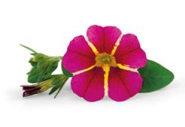
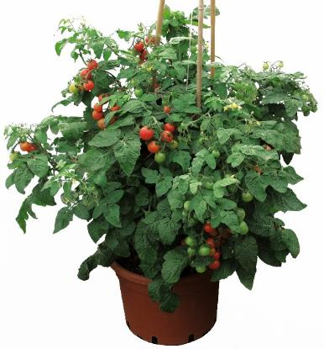
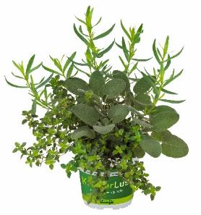
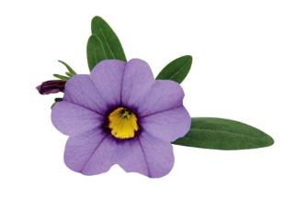
Neuheiten
Novelties
Season 2024/2025

Slide 2
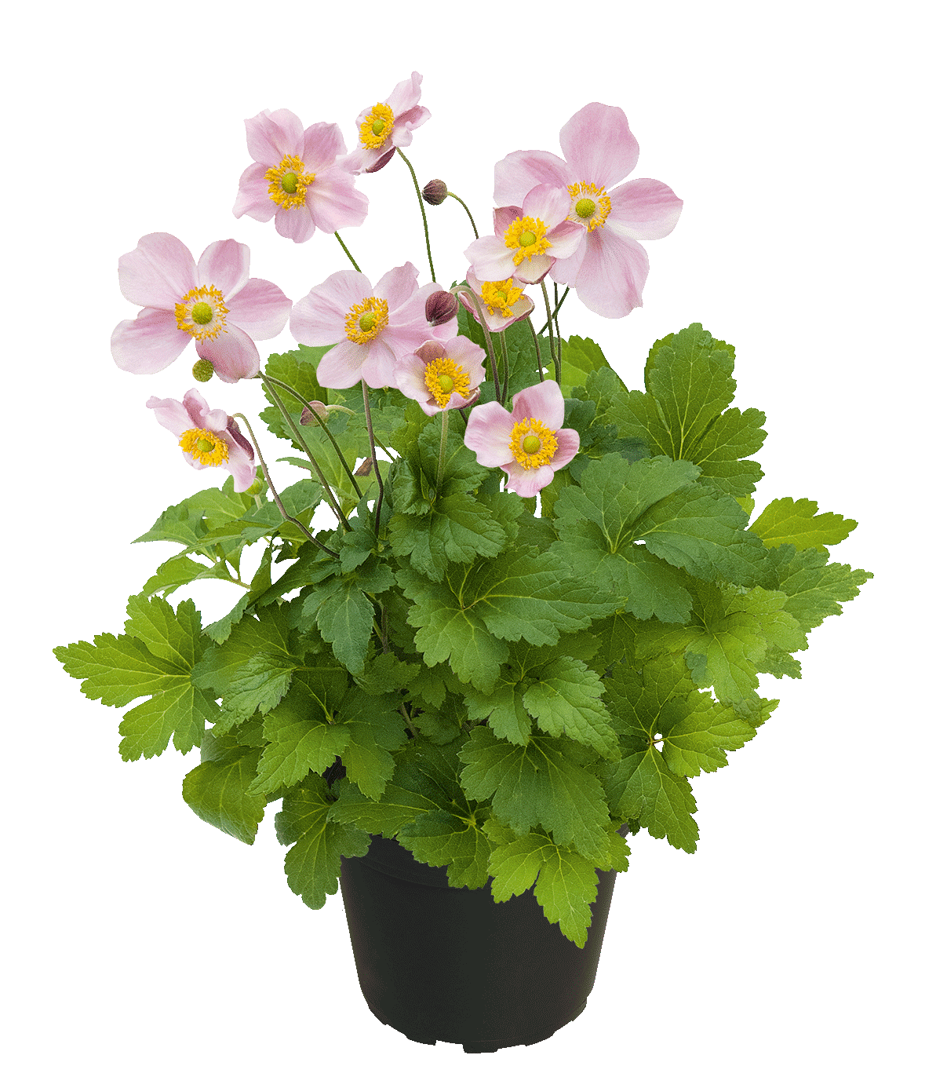
Anemone Soft Grace

Slide 3
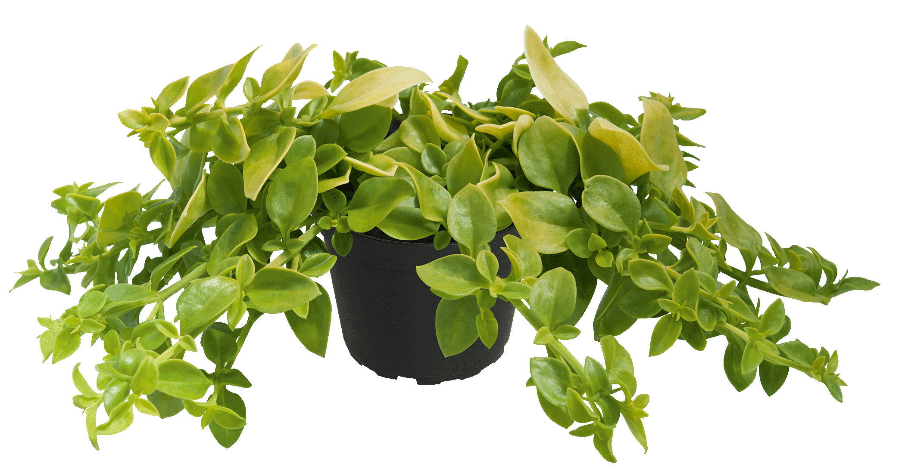
Aptenia Golden Cascade

Slide 4
Argyranthemum Sweet Ice

Slide 5
Argyranthemum Dark Lolly

Slide 6
Argyranthemum Citrus 2025
NEU

Slide 7
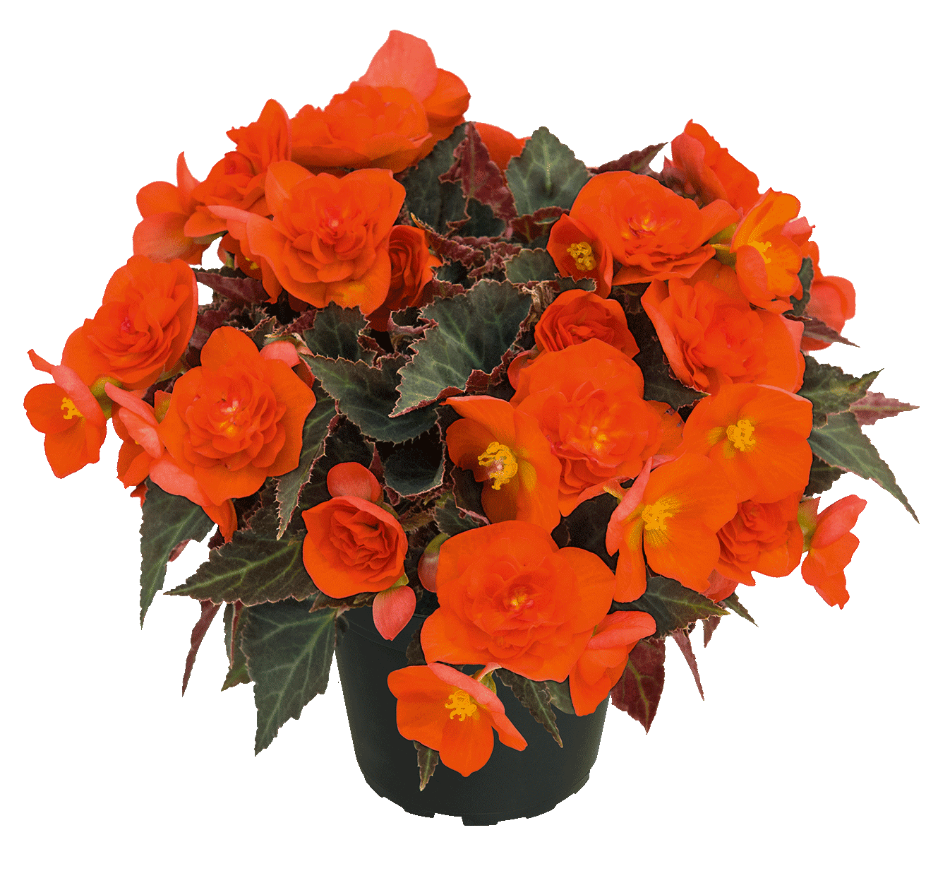
Begonia BELLISSA Flame

Slide 8
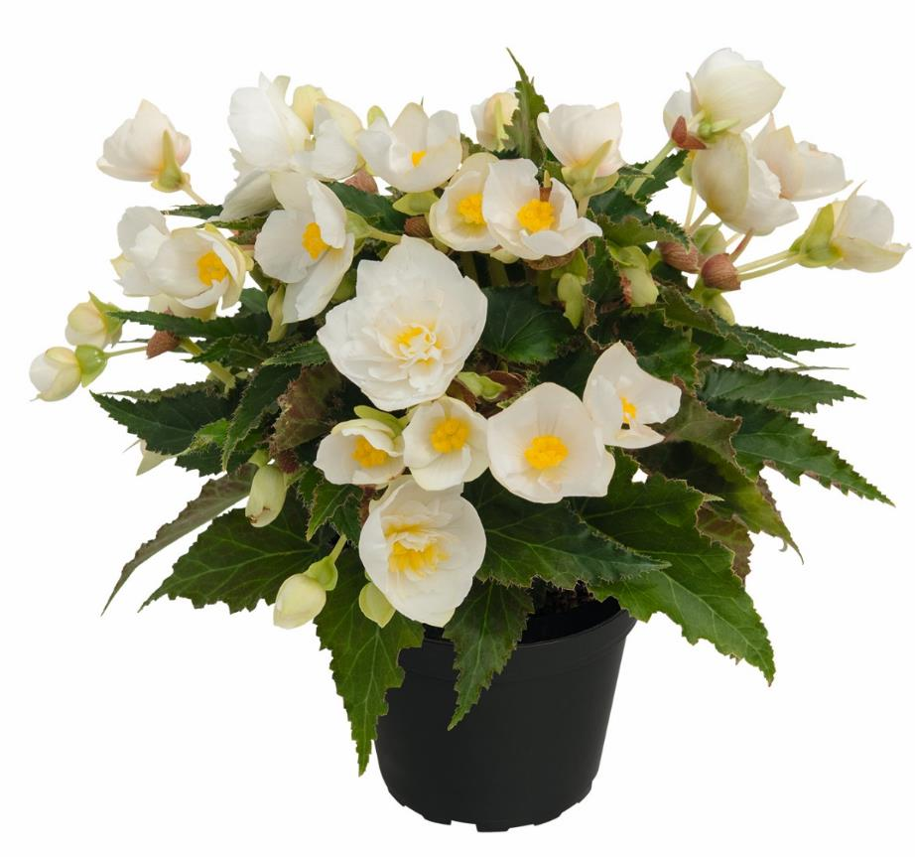
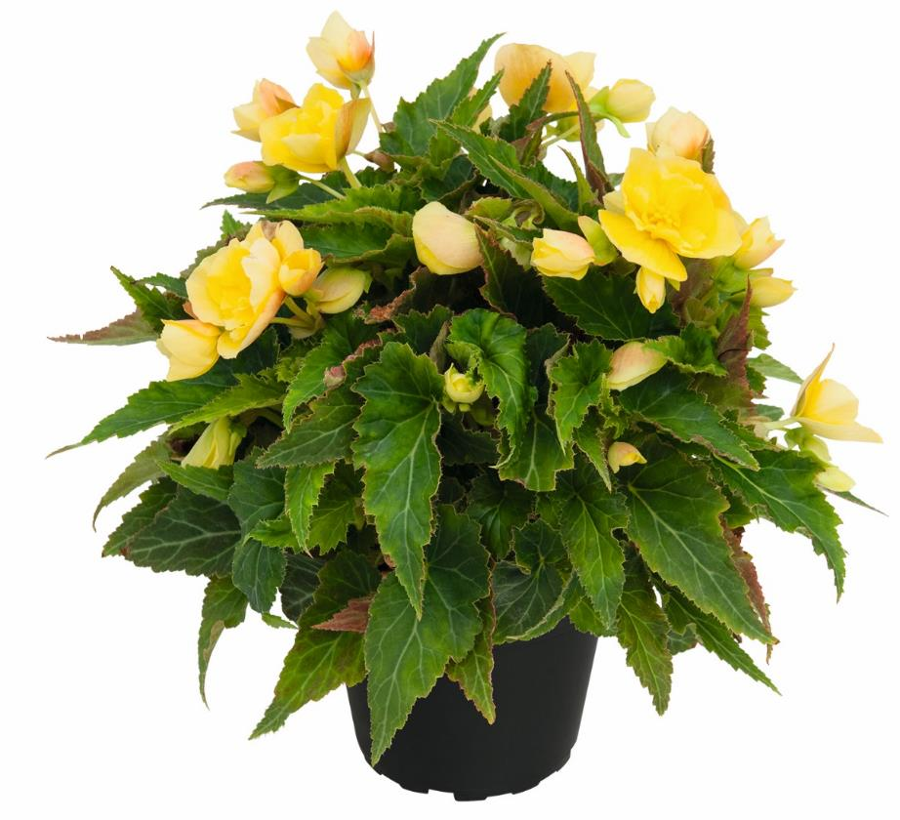
Begonia BELLISSA
BELLISSA Yellow
BELLISSA White

Slide 9
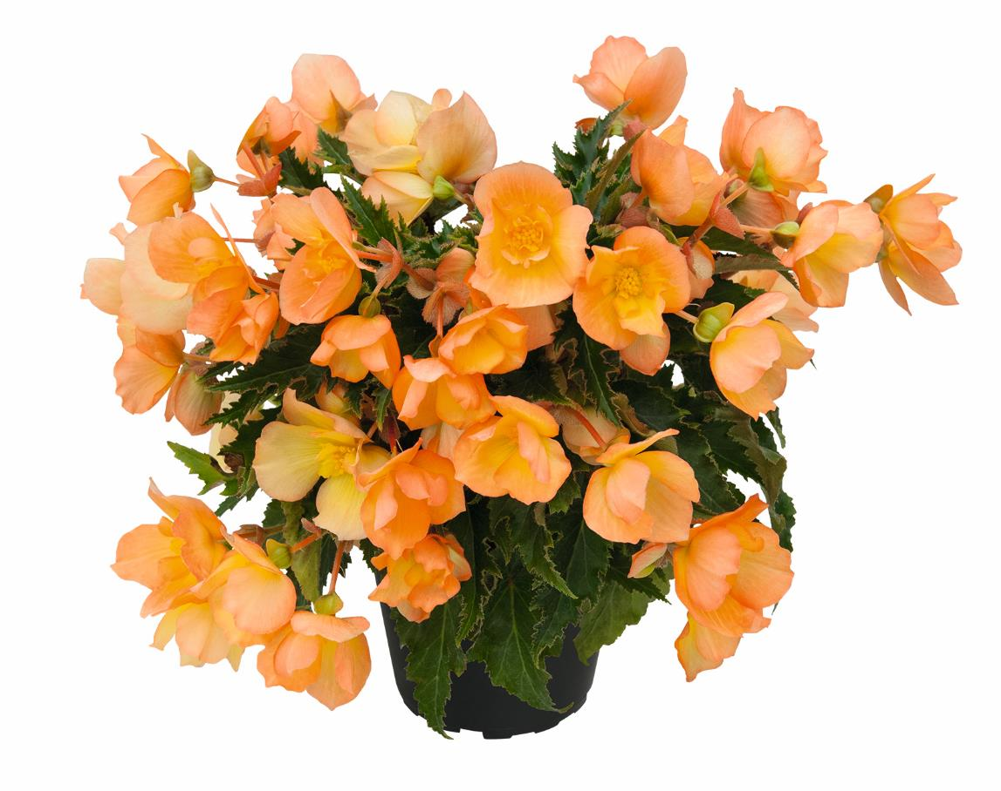
Begonia BELLISSA Daybreak (B20 08-20)

Slide 10
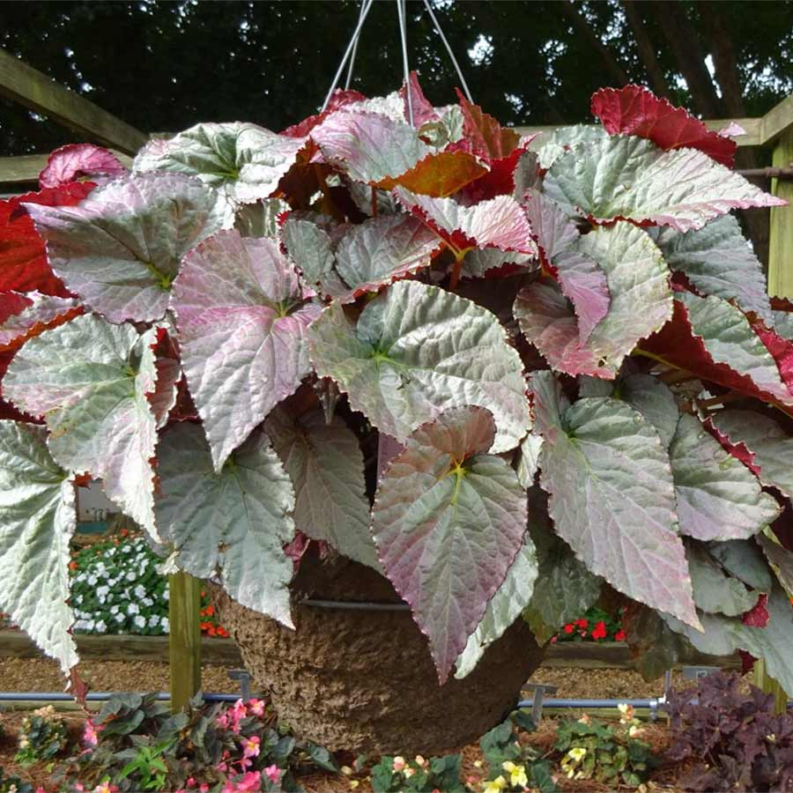
Begonia SILVER Treasure

Slide 11
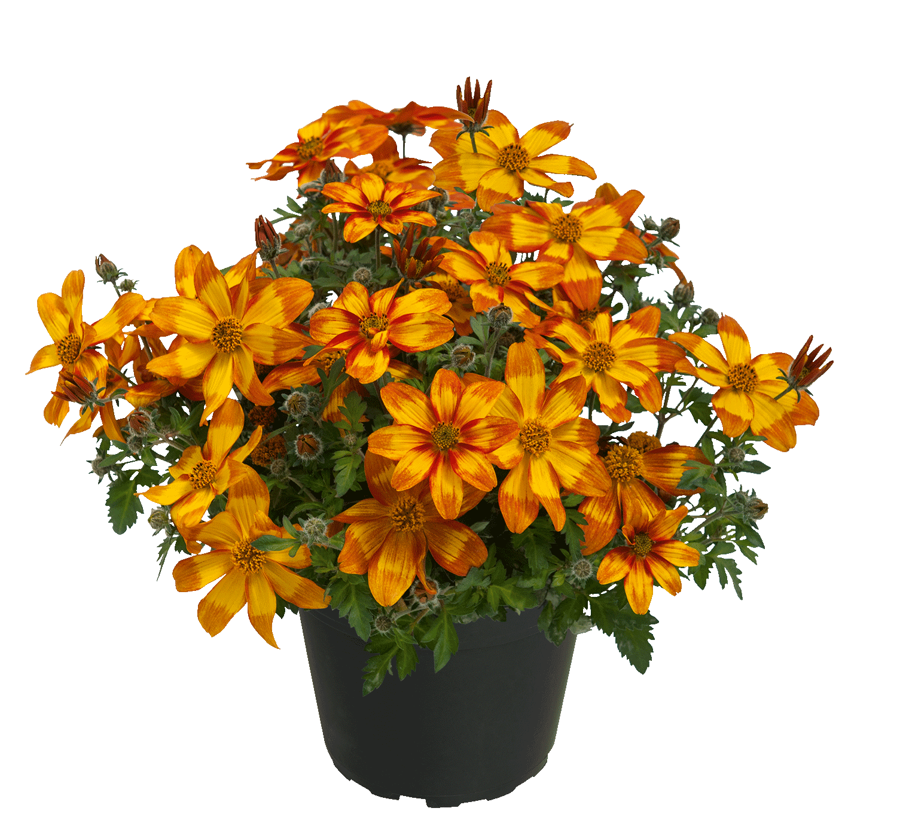
Bidens Funny Honey 2025

Slide 12
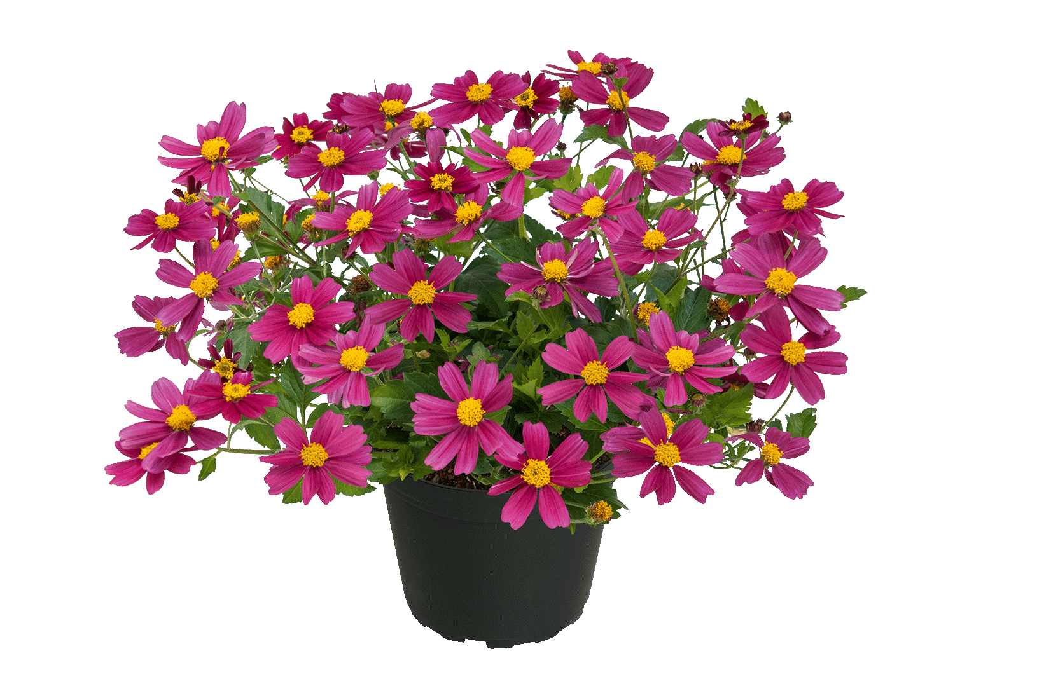
Bidens Bee My Sunshine

Slide 13
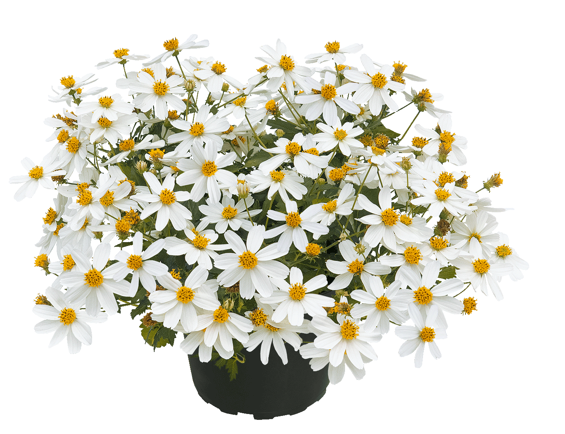
Bidens Bee White 2025

Slide 14
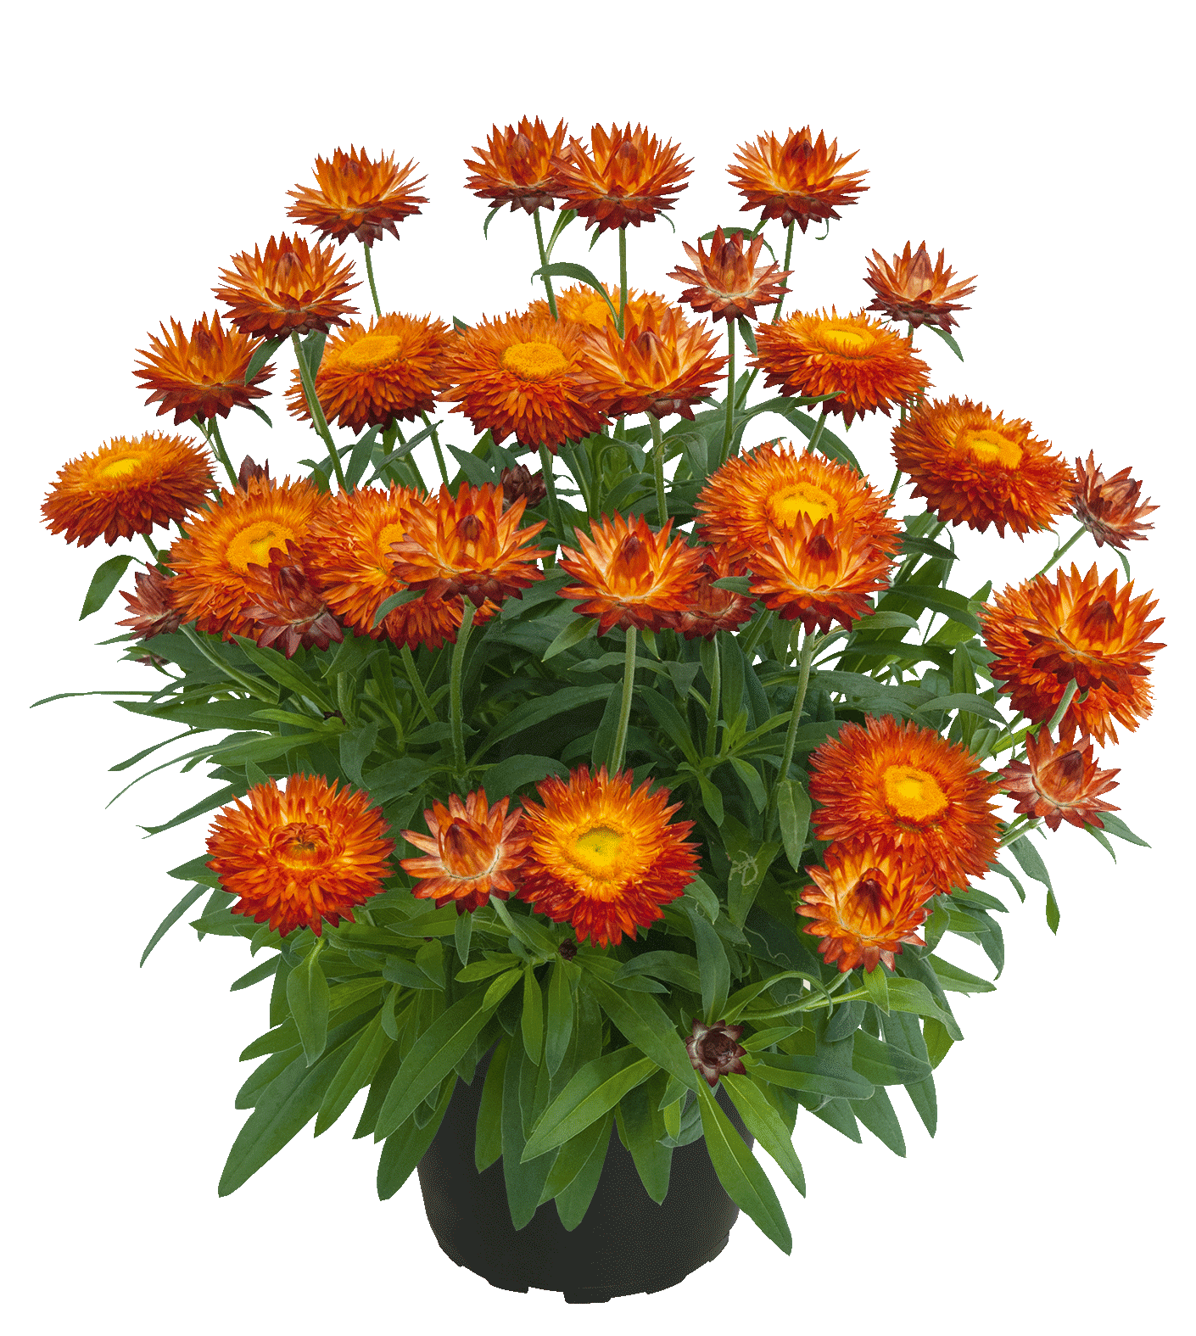
Bracteantha Sunbrella Orange 2025

Slide 15
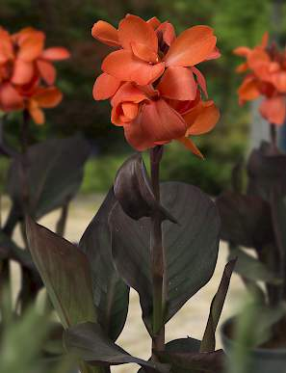
Canna CannaSol Wilma

Slide 16
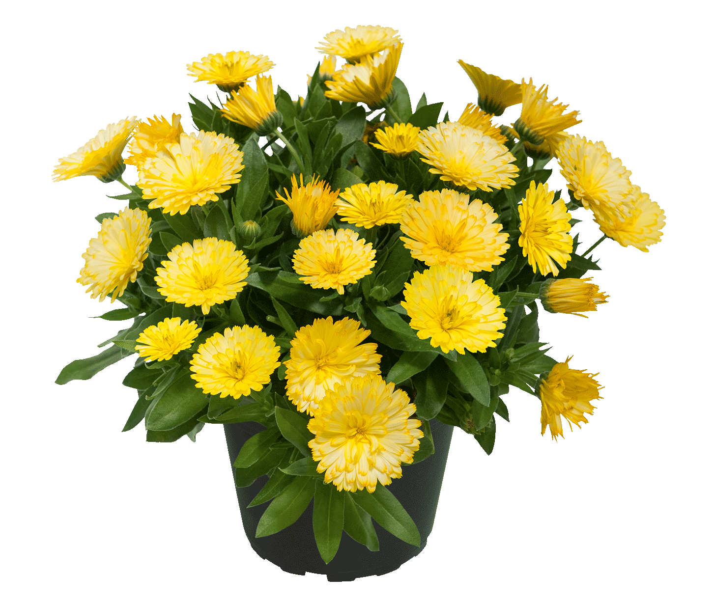
Calendula POWERDAISY Buttermilk

Slide 17
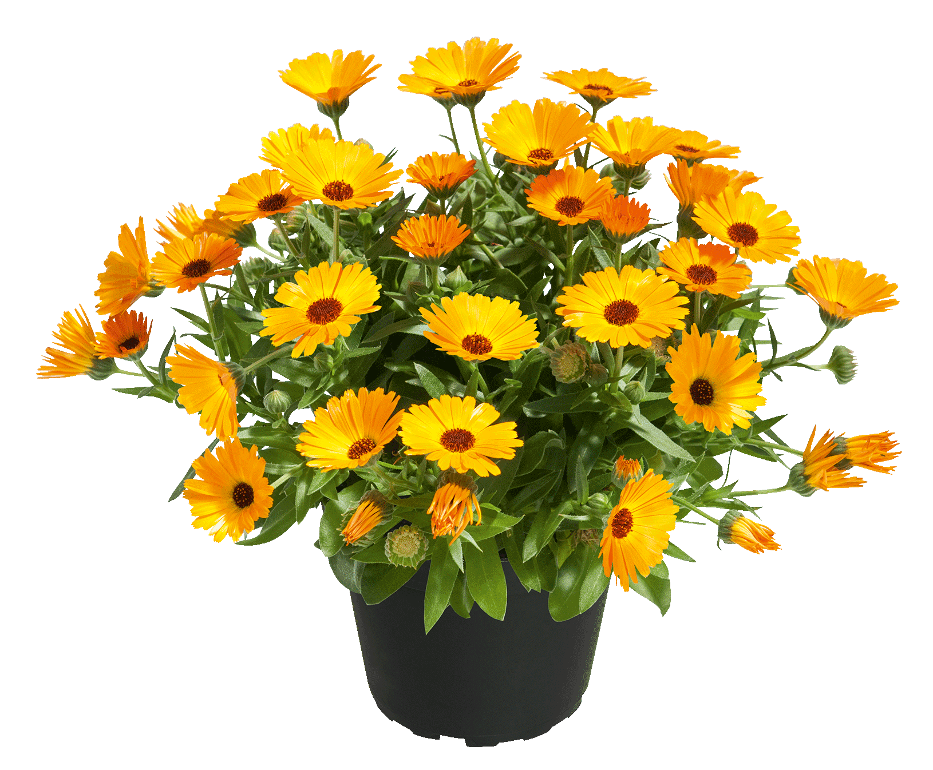
Calendula POWERDAISY Mango

Slide 18
Calibrachoa POCKET Orchid

Slide 19
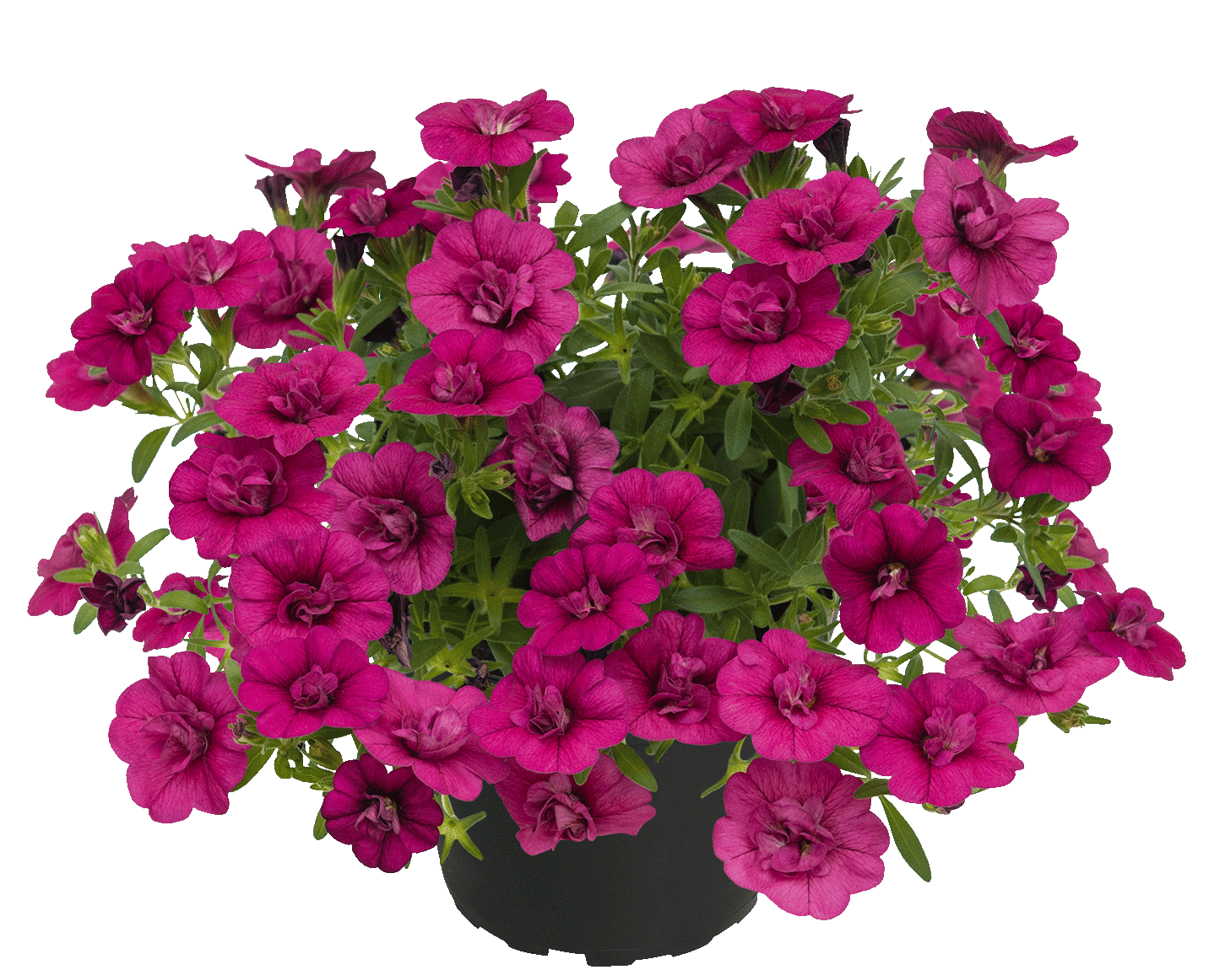
Calibrachoa POCKET Double Magenta

Slide 20
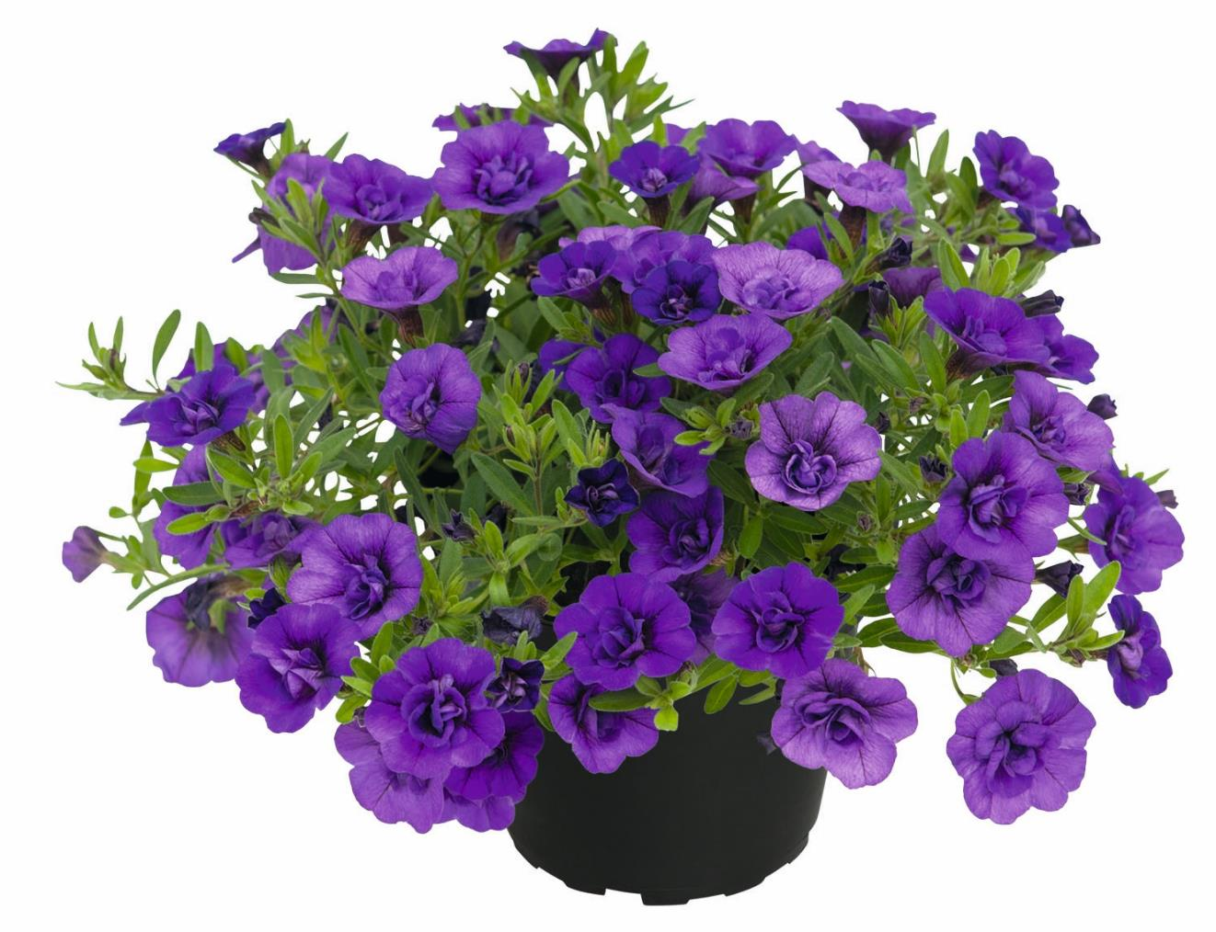
Calibrachoa POCKET Double Lilac

Slide 21
Calibrachoa UNIQUE Sangria Picotee

Slide 22
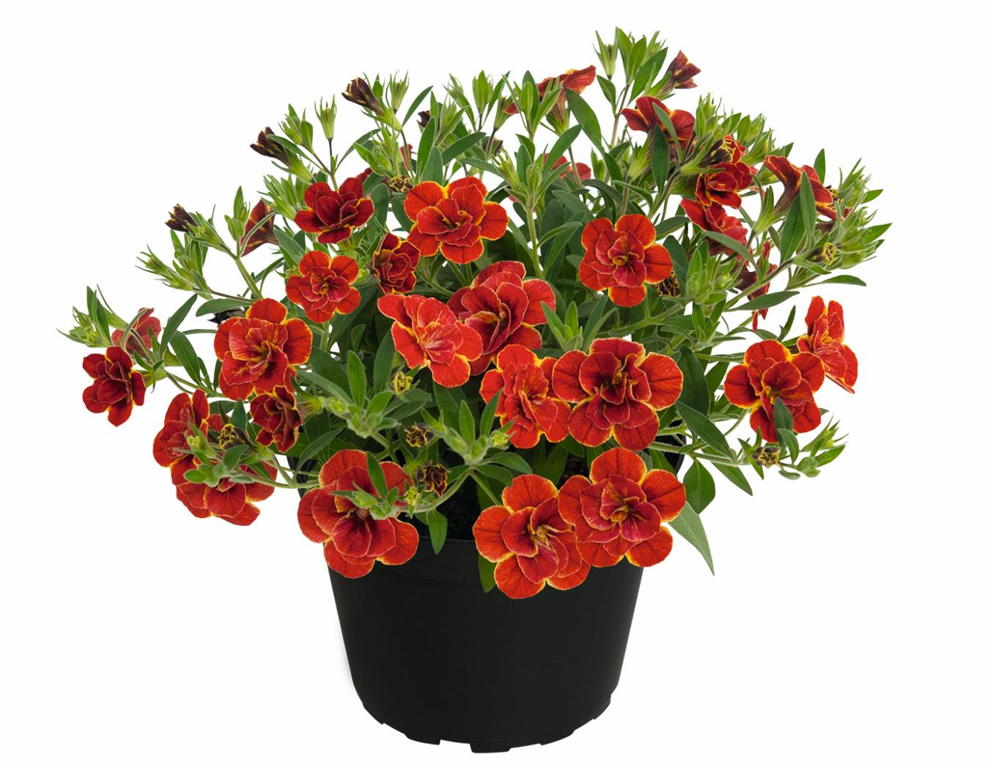
Calibrachoa SUPERBELLS Double Redstone

Slide 23
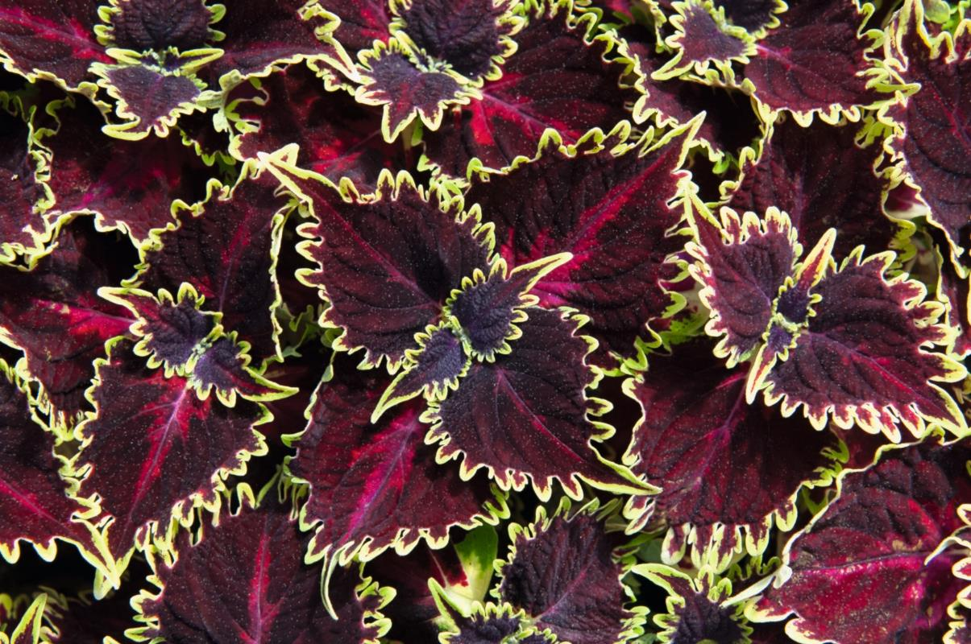
Coleus (Plectranthus) Drama

Slide 24
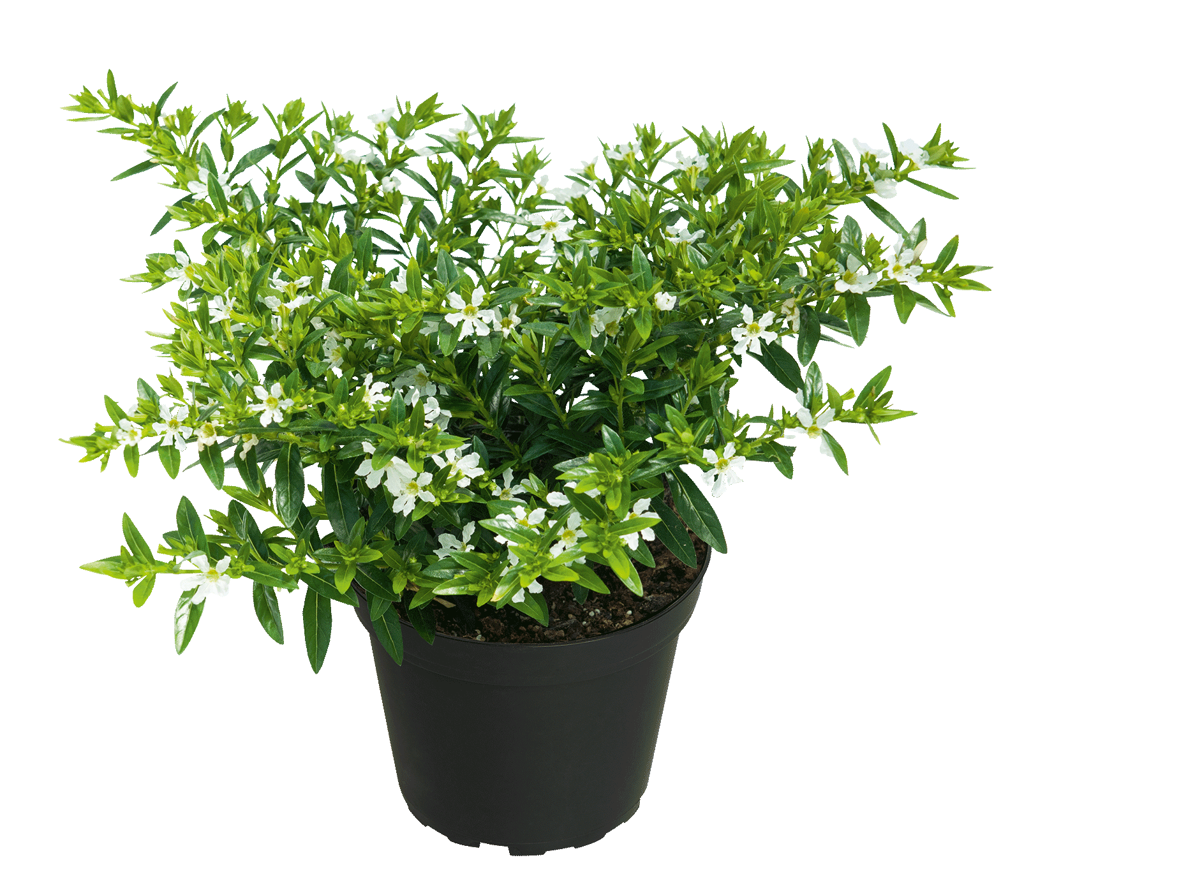
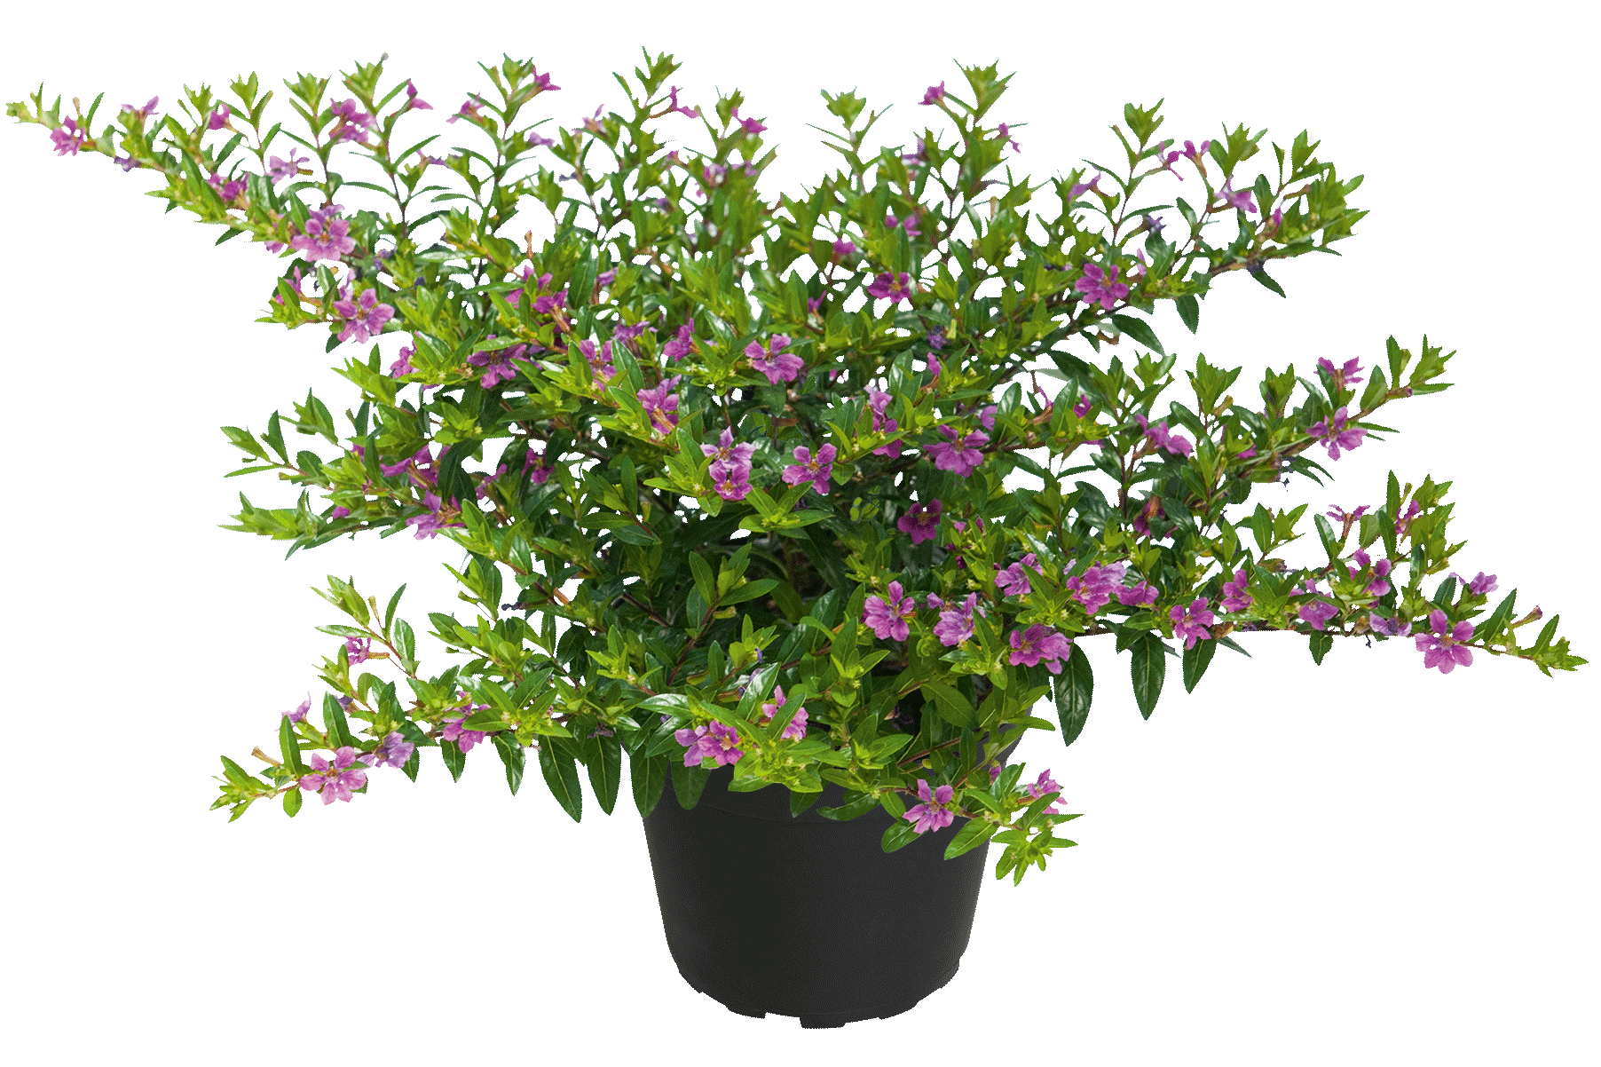
Cuphea CUPPY
CUPPY White
CUPPY Magenta

Slide 25
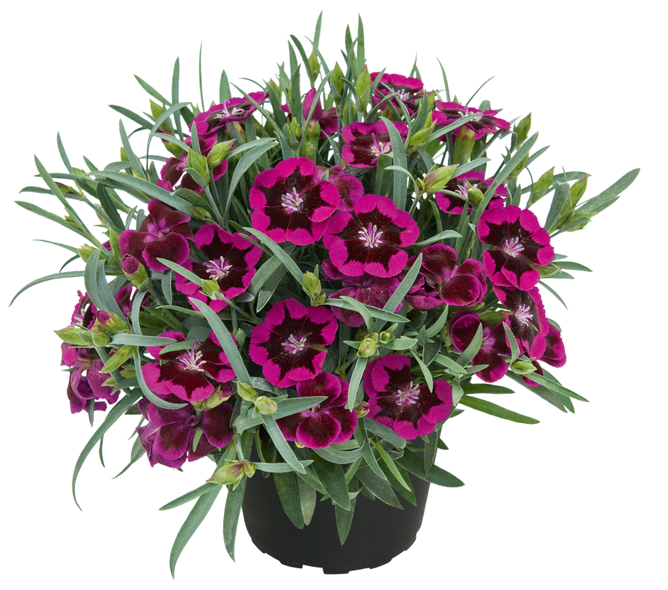
Dianthus Berry Touch

Slide 26
Dianthus Suntory Raspberry

Slide 27
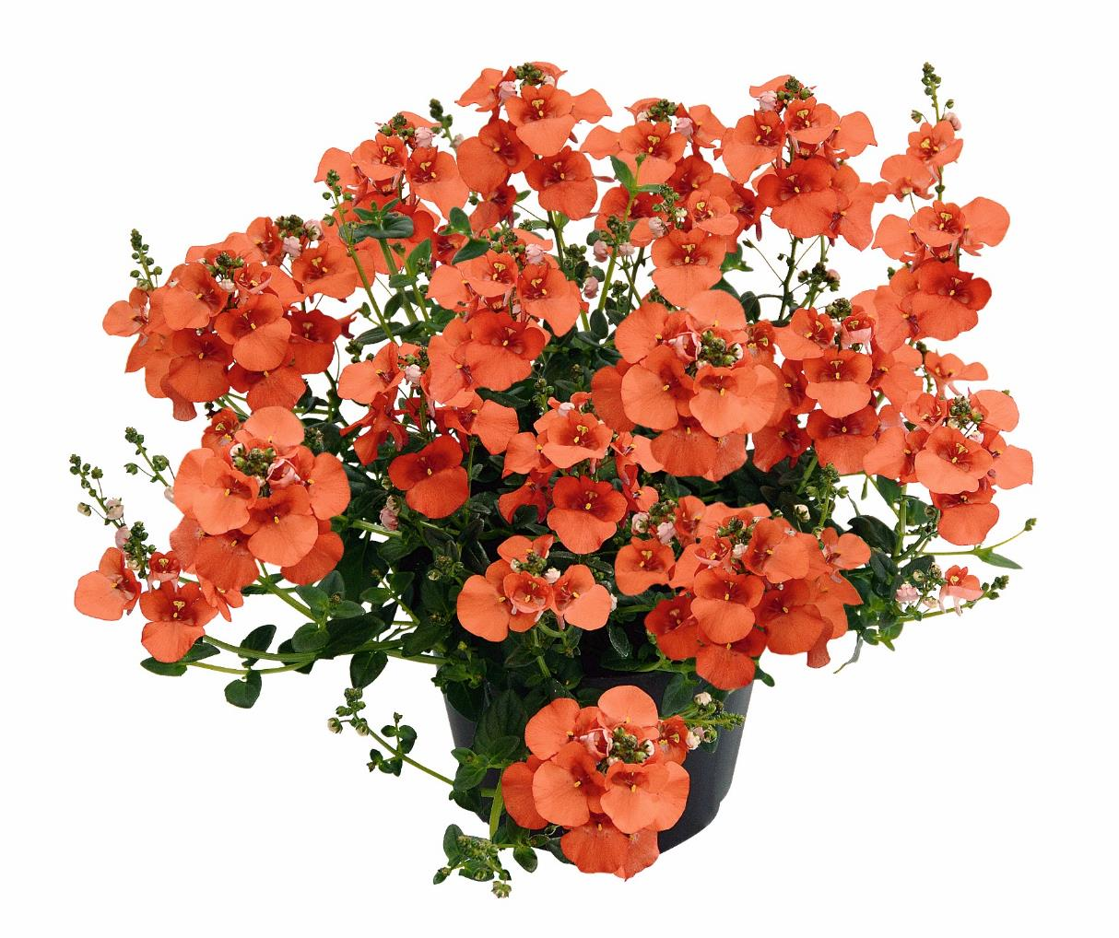
Diascia Breezee Orange 2025

Slide 28
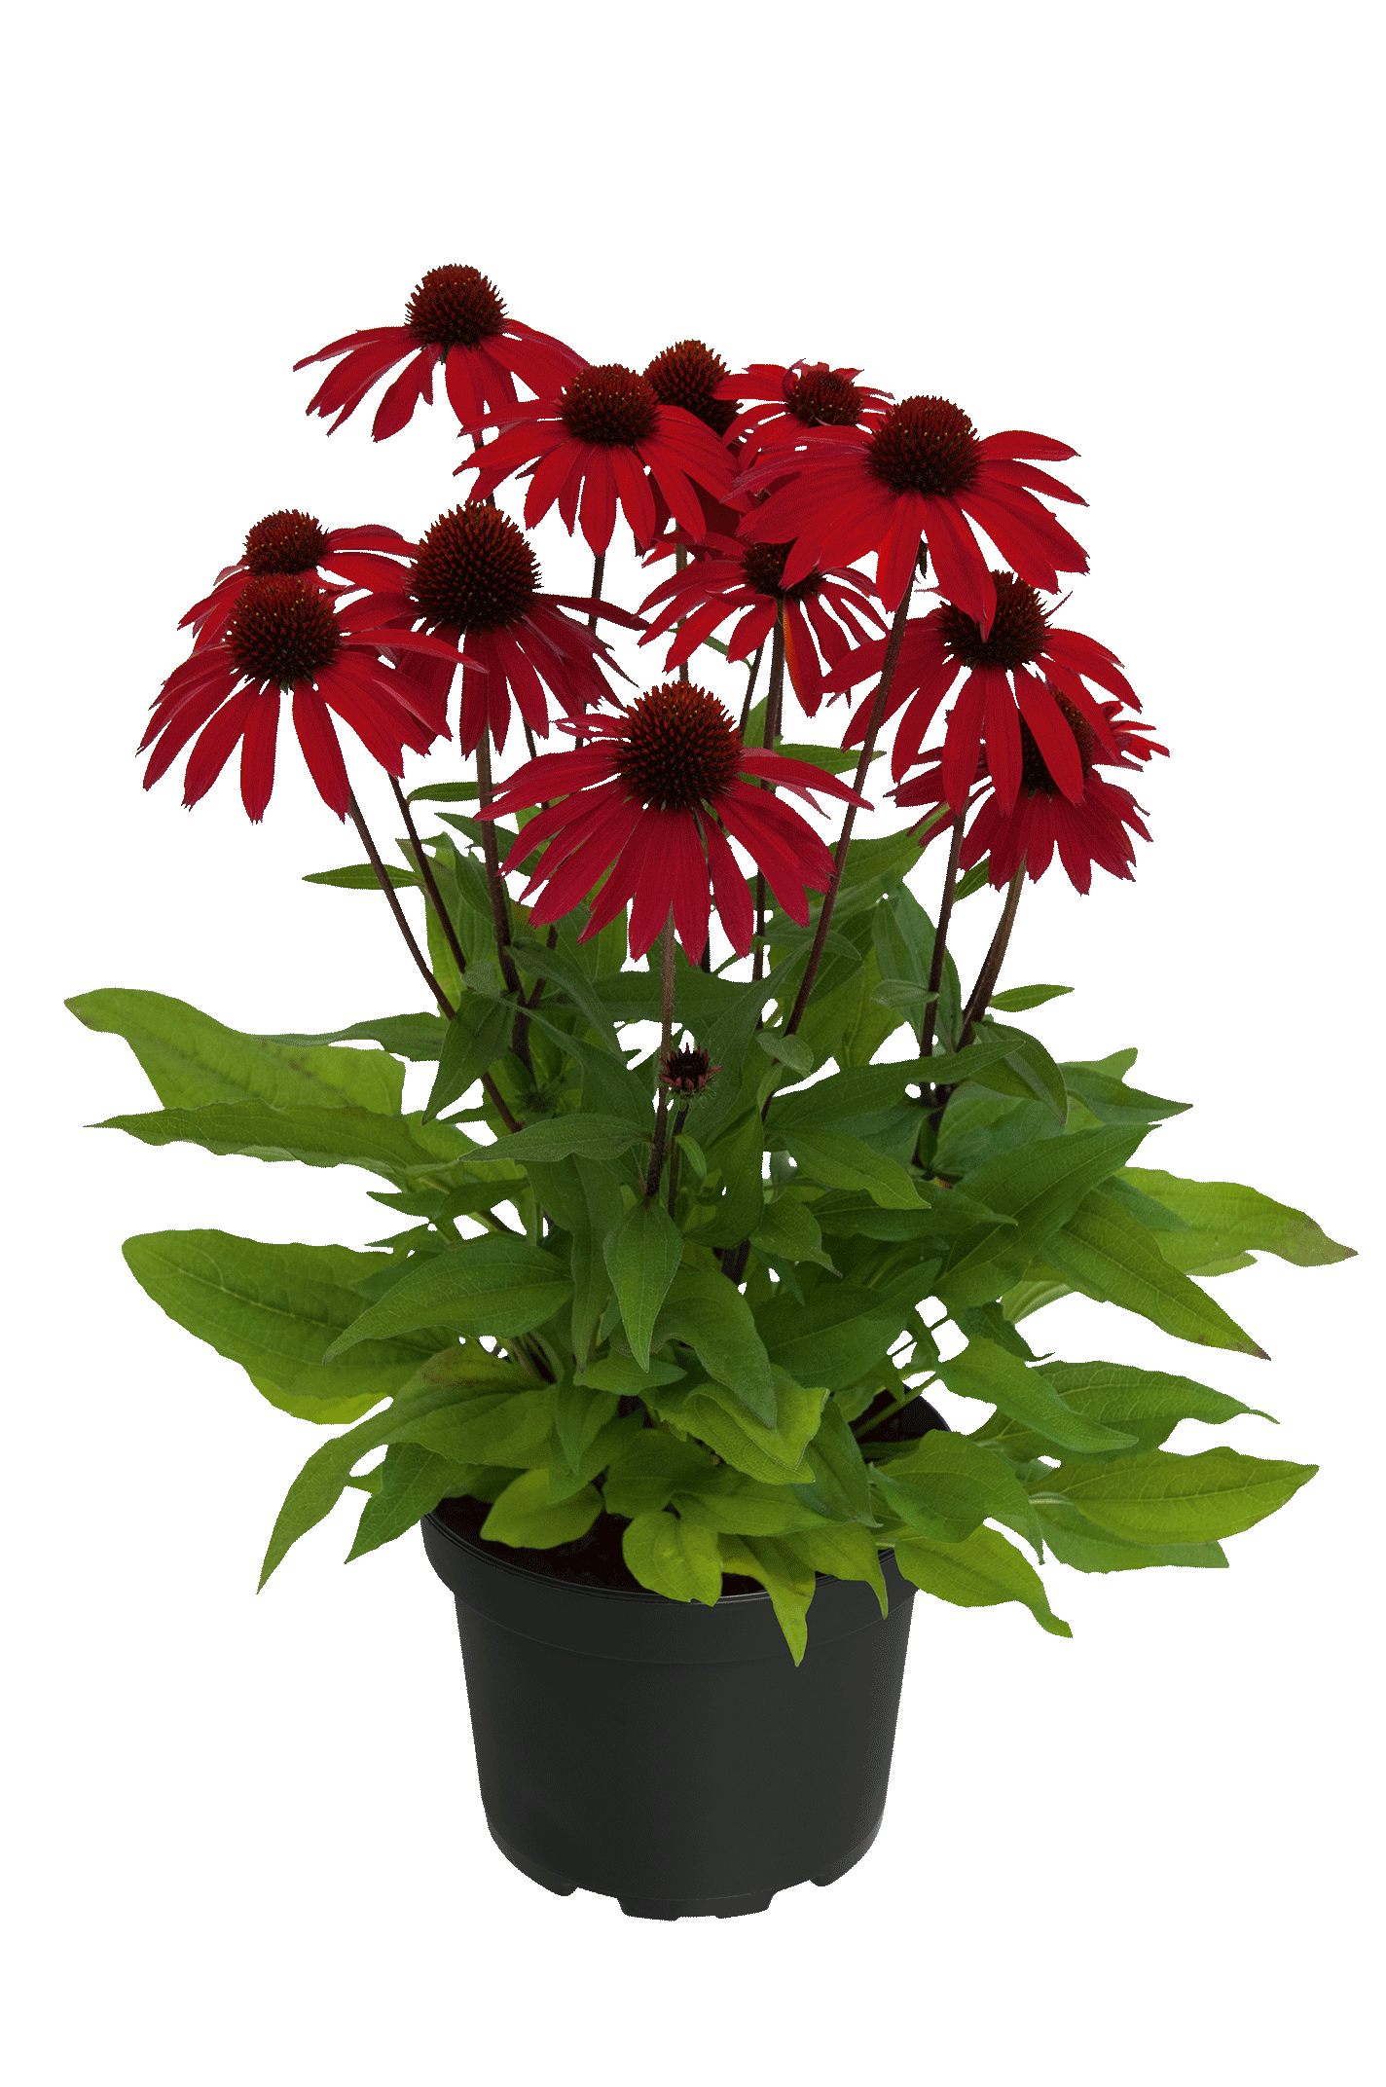
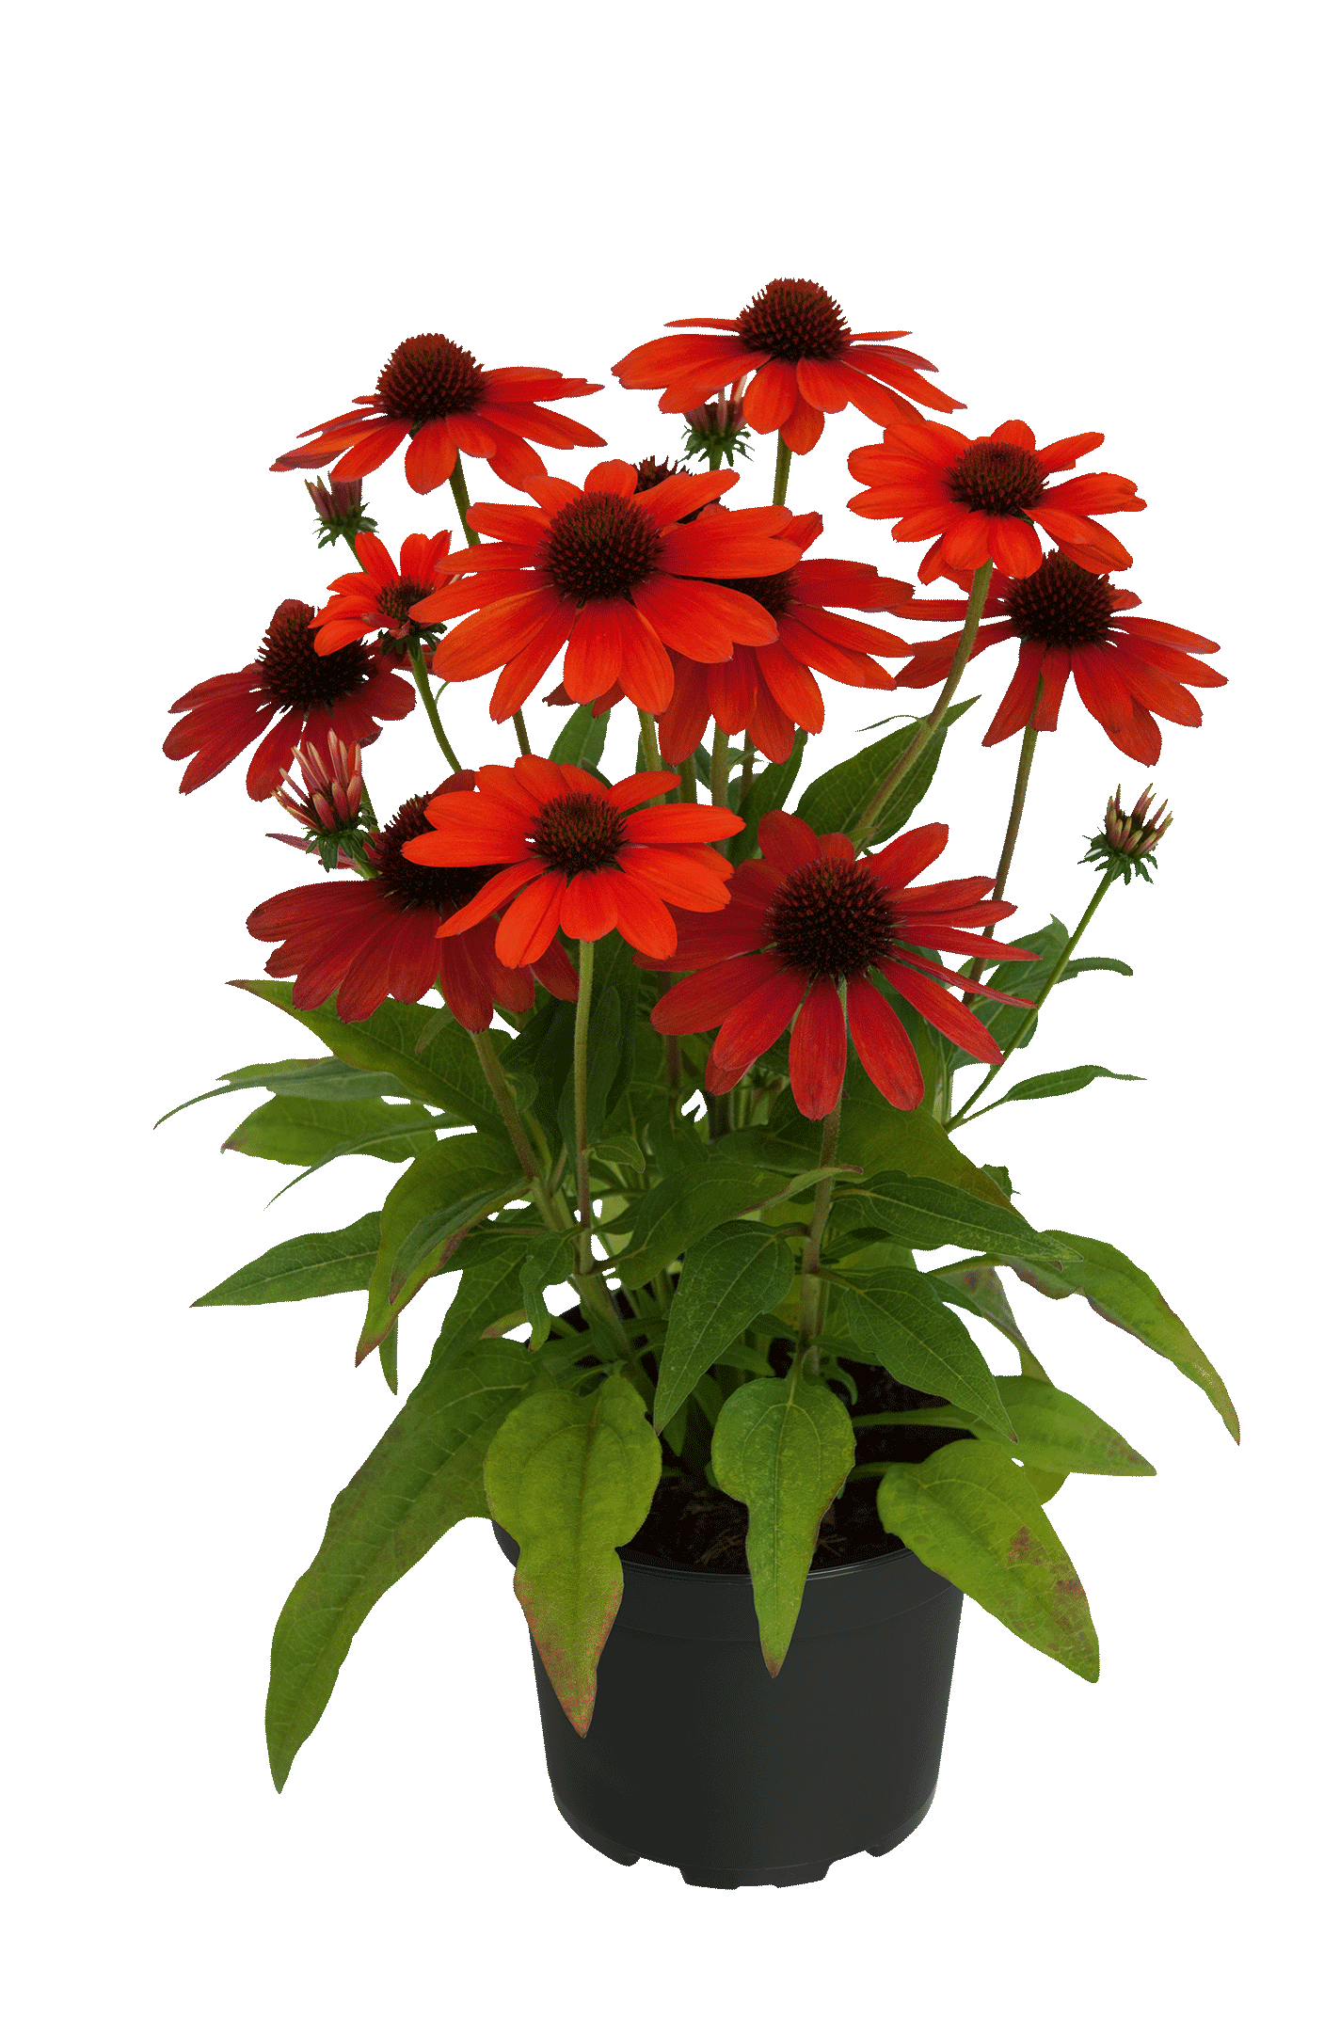
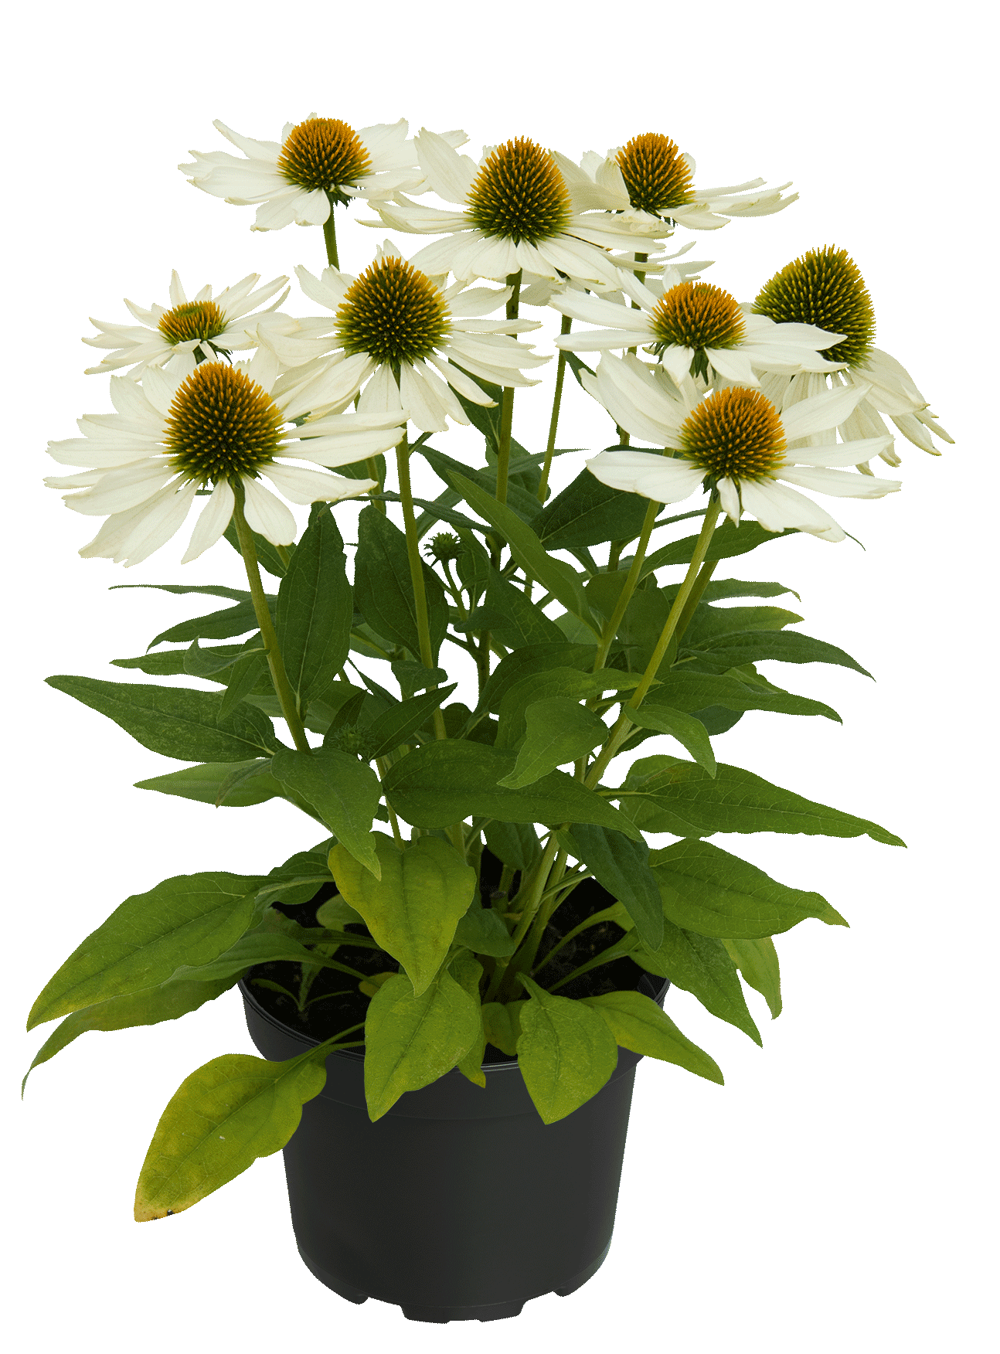
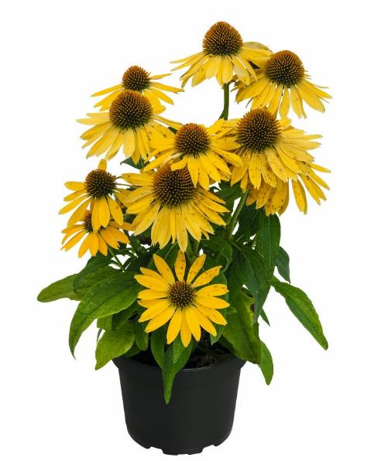
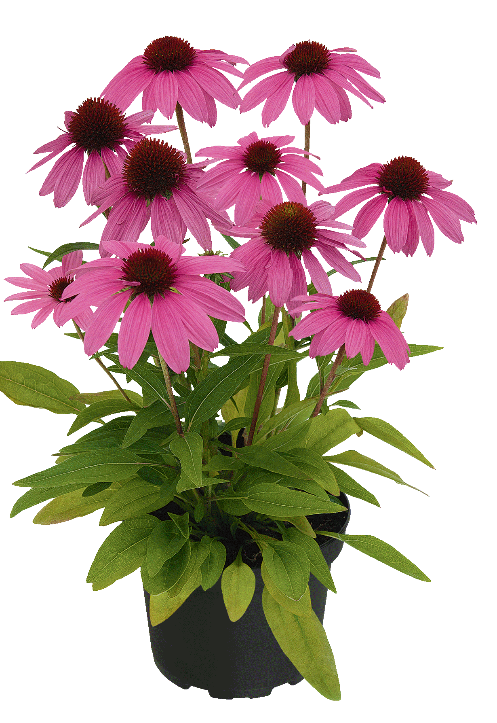
Echinacea SUNMAGIC

Slide 29
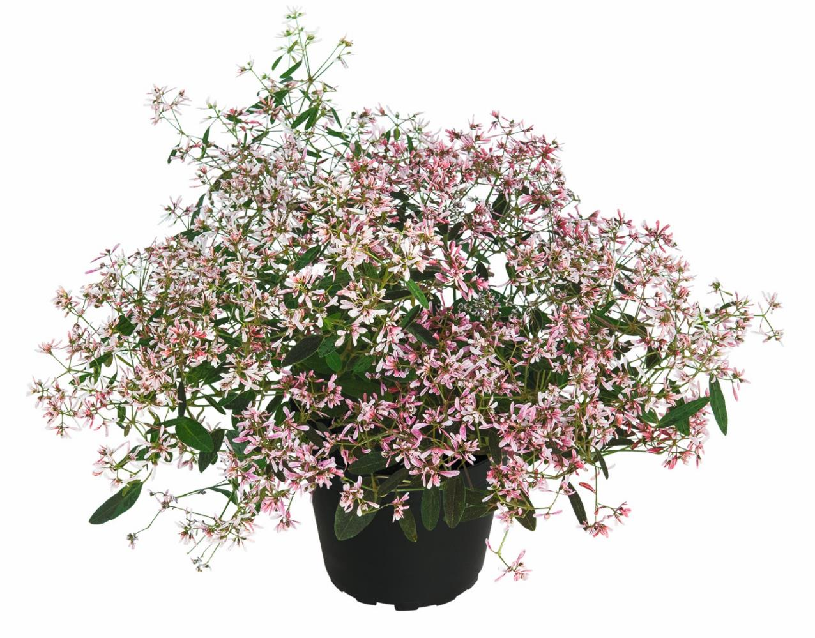
Euphorbia Shades in Pink

Slide 30
Euphorbia Diamond Rose Experimental

Slide 31
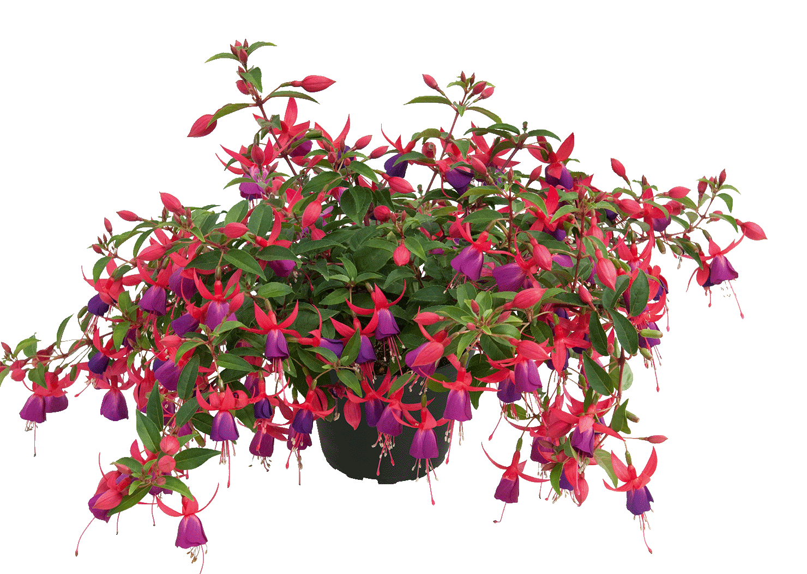
Fuchsia SHADOWDANCER Trailing ‚Nadja‘

Slide 32
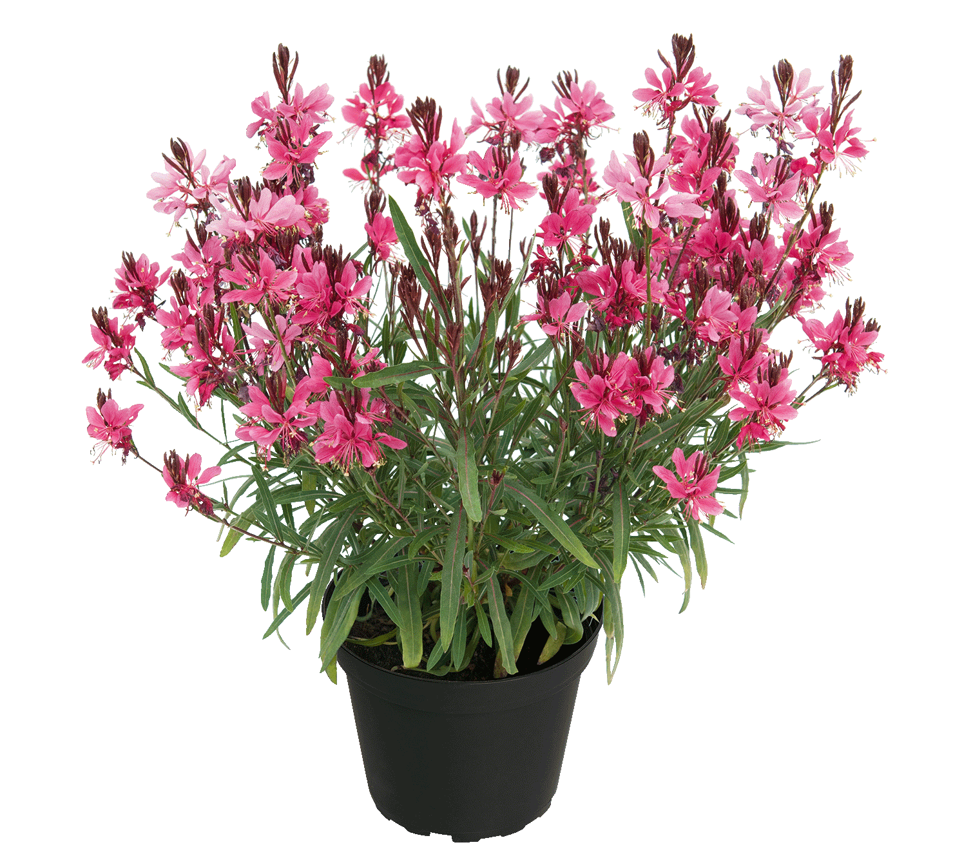
Gaura EVERLAST Dark Pink

Slide 33
Gaura EVERLAST Light Pink

Slide 34
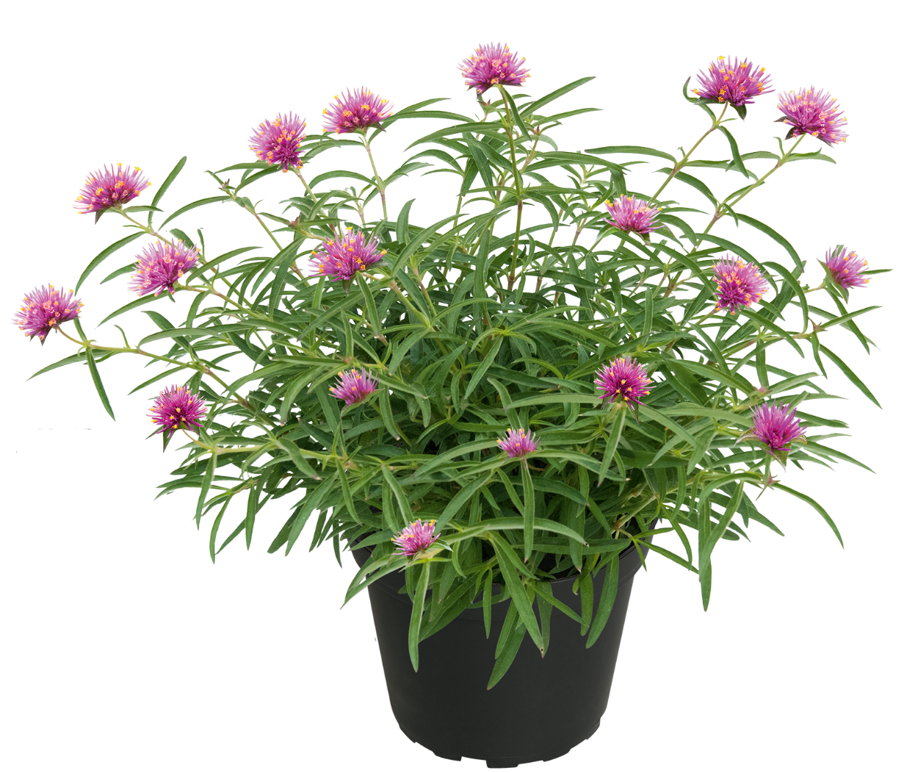
Gomphrena Truffula Pink 2025

Slide 35
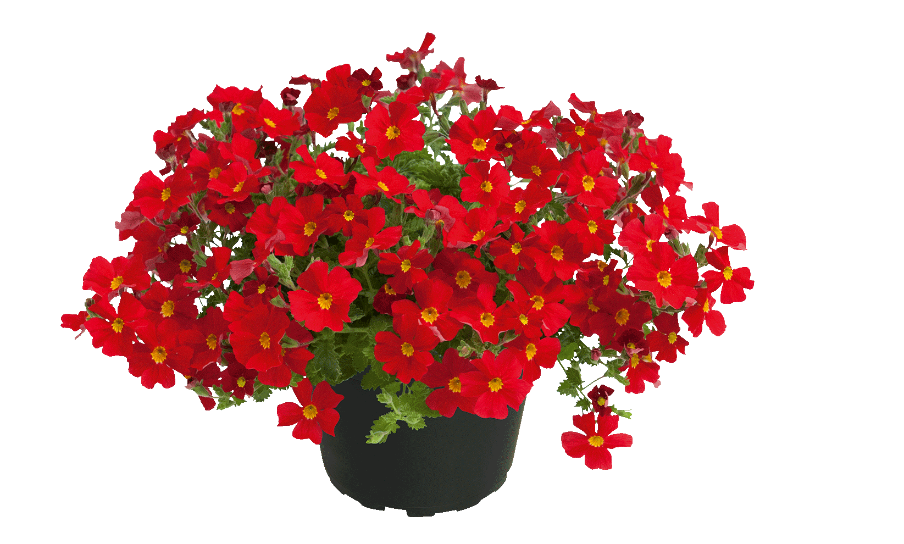
Jamesbrittania SAFARI Lava

Slide 36
Jamesbrittania SAFARI Fuchsia

Slide 37
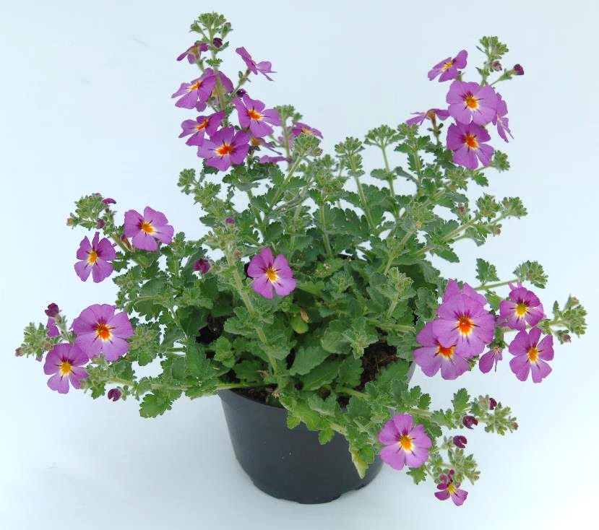
Jamesbrittania SAFARI Sky

Slide 38
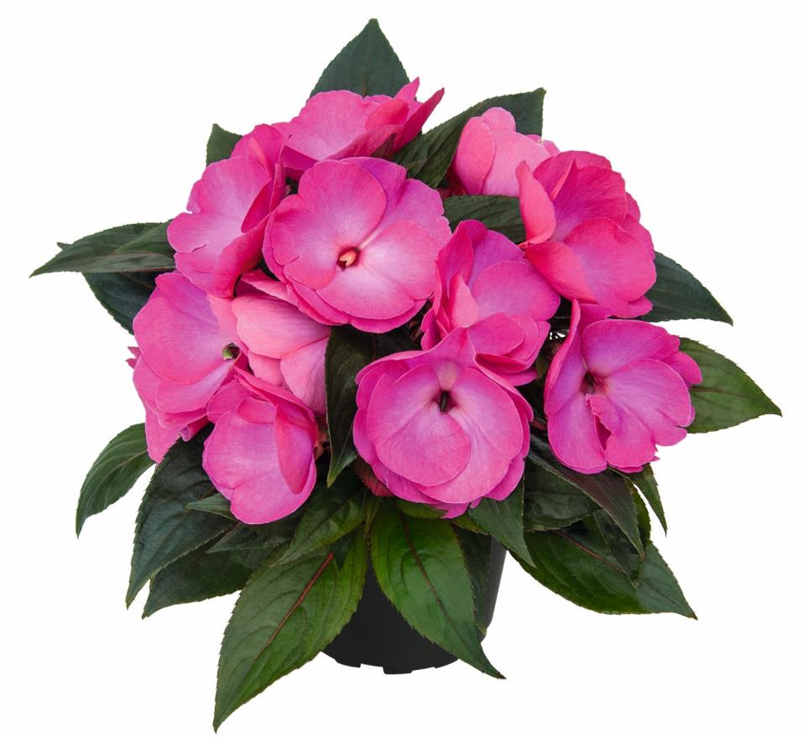
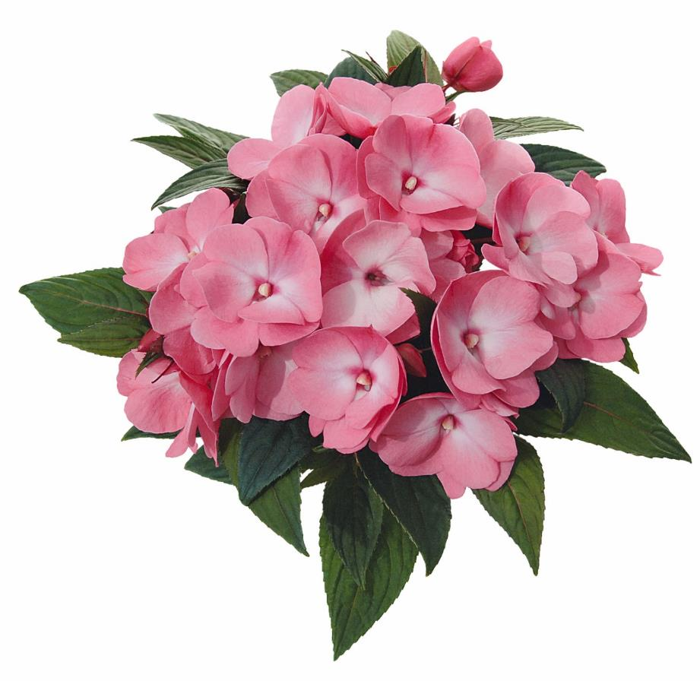
NGI Paradise
Pasito (#15)
Nagena 2025 (#56)

Slide 39
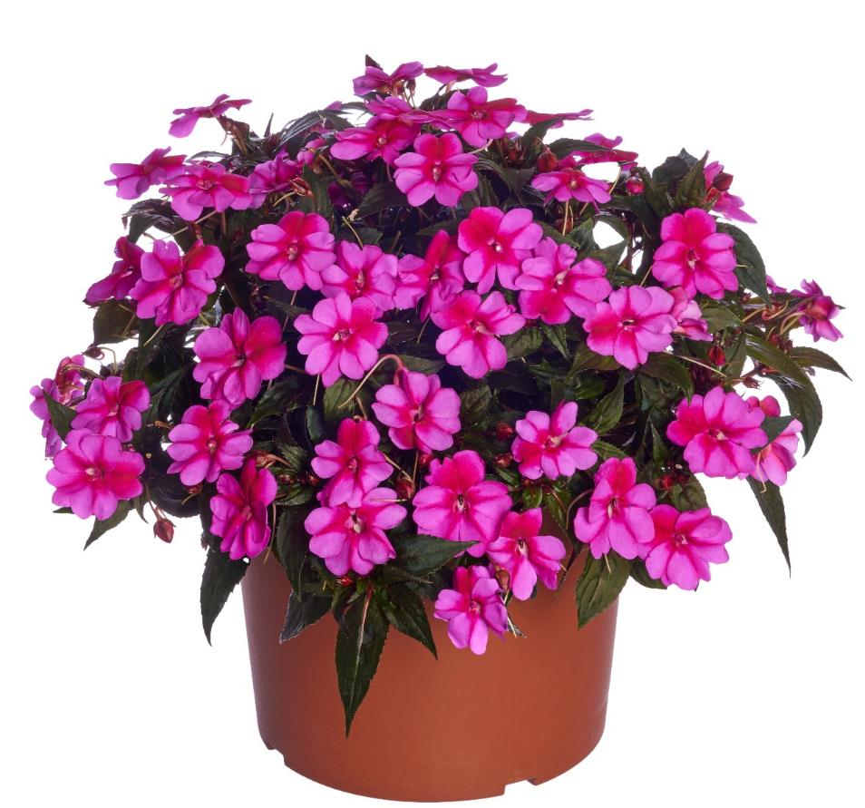
SUNPATIENS Compact Purple Candy Improved

Slide 40
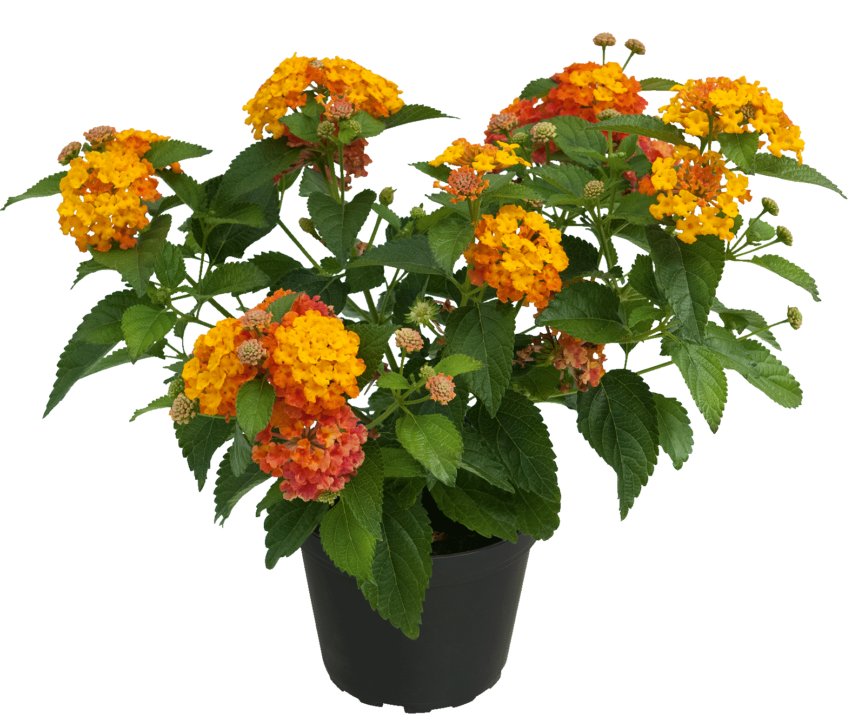
Lantana CALIPPO Tropical Twist

Slide 41
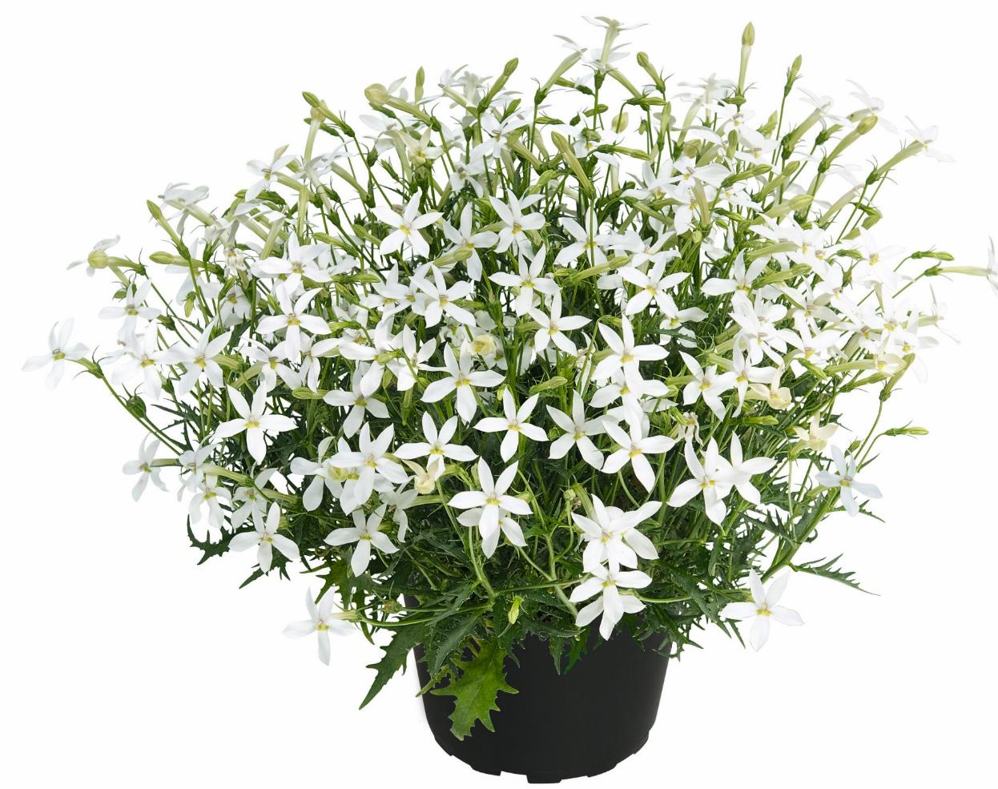
Laurentia Wendy‘s White 2025

Slide 42
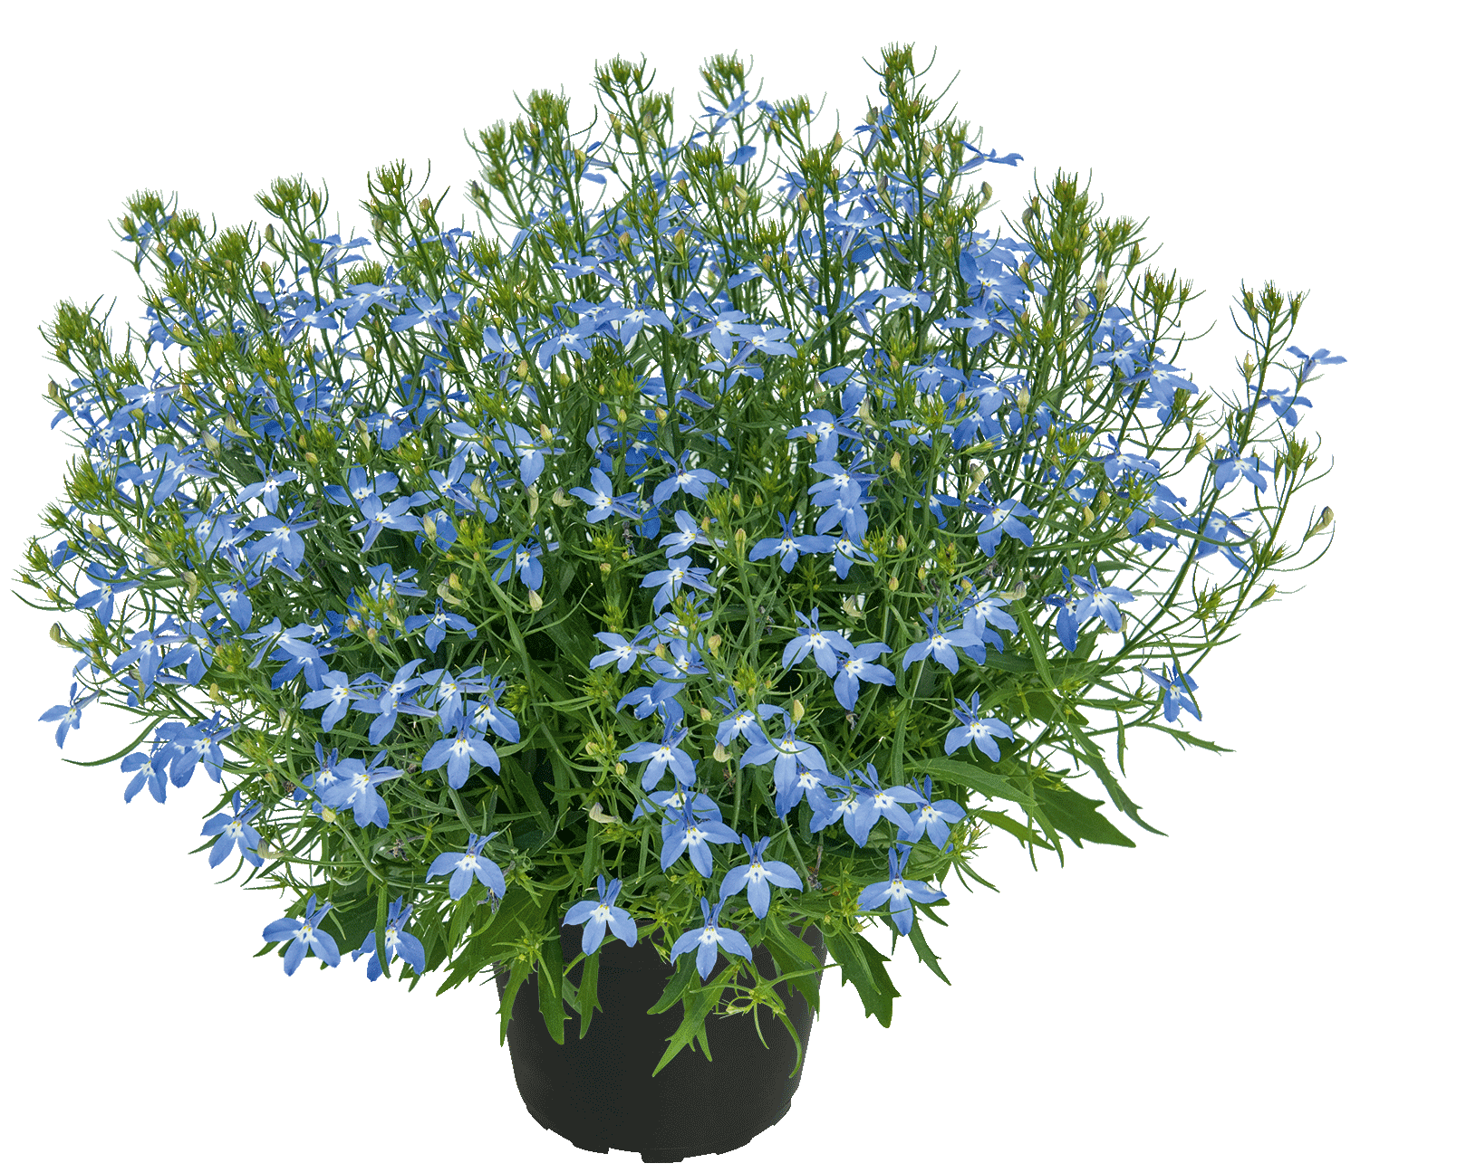
Lobelia Sparkling Sky

Slide 43
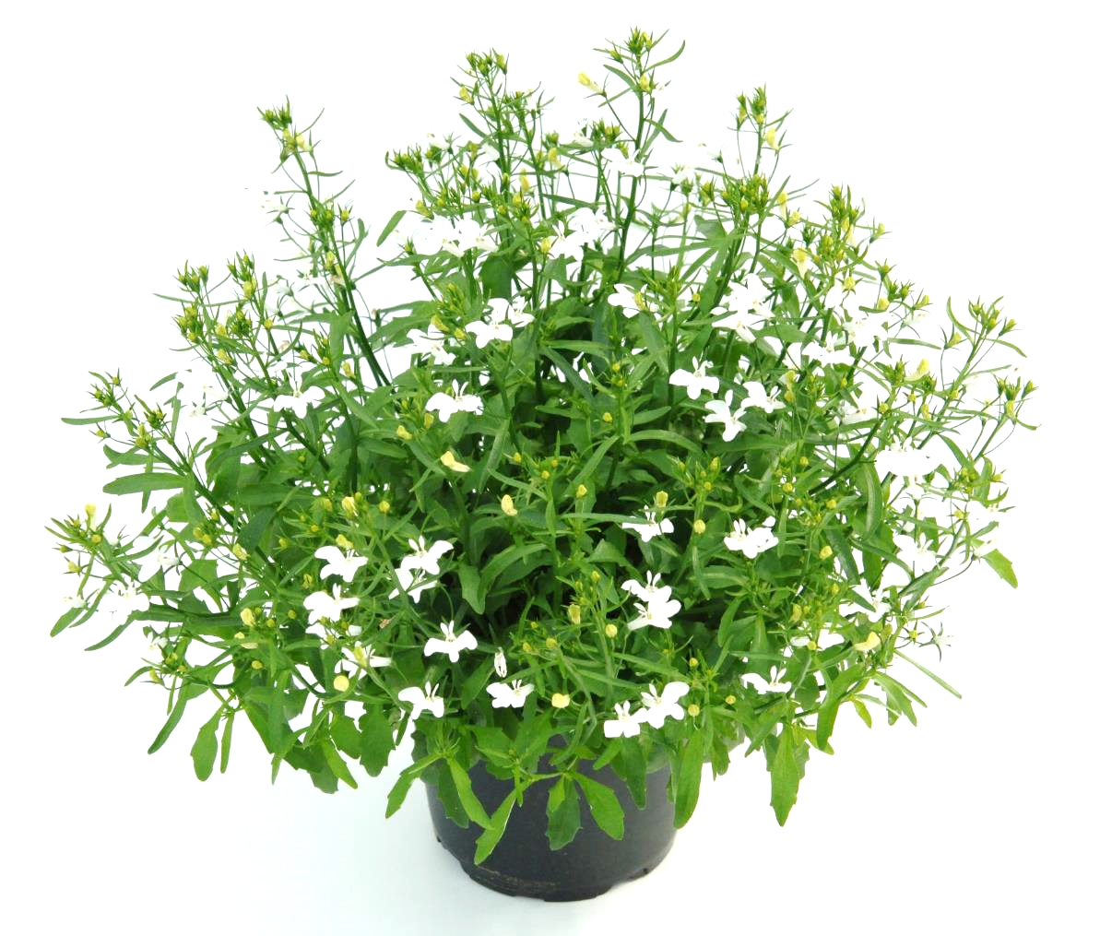
Lobelia Sparkling Snow

Slide 44
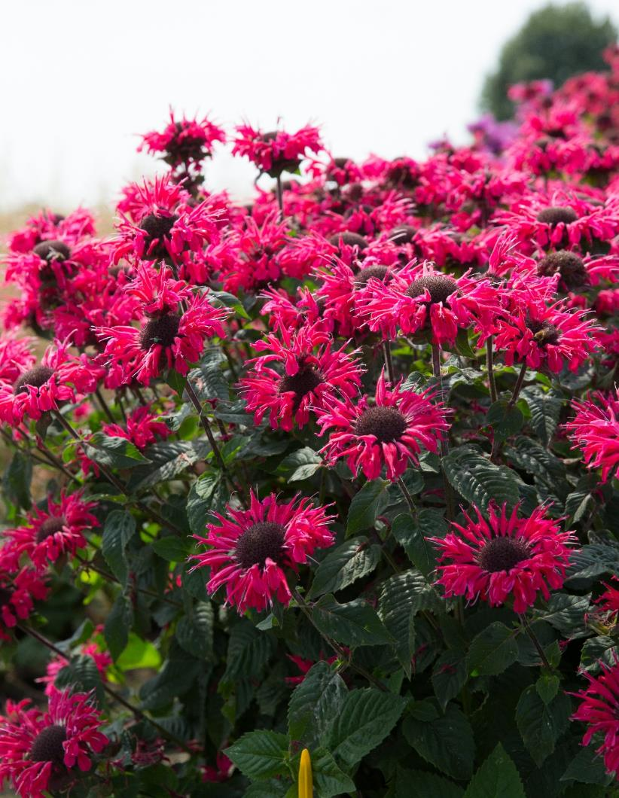
Monarda BEE Happy

Slide 45
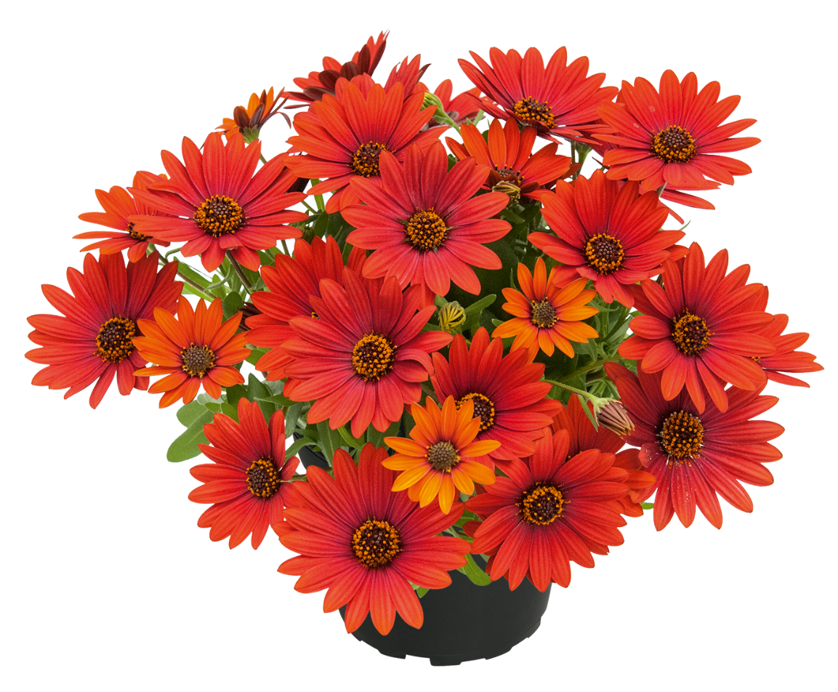
Osteospermum SUMMERSMILE Sangria

Slide 46
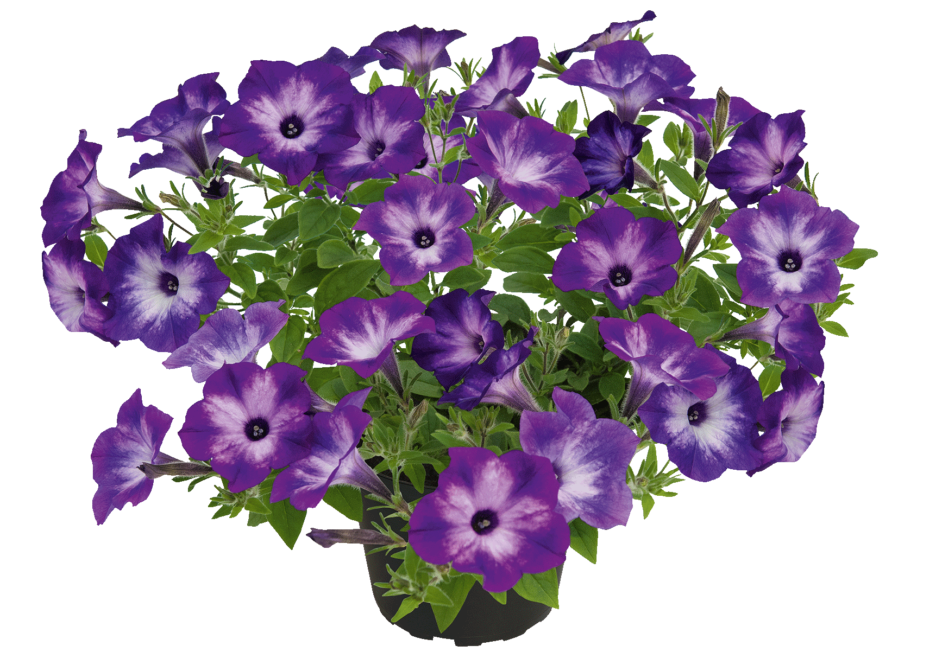
Petunia Vista Blue Moon

Slide 47
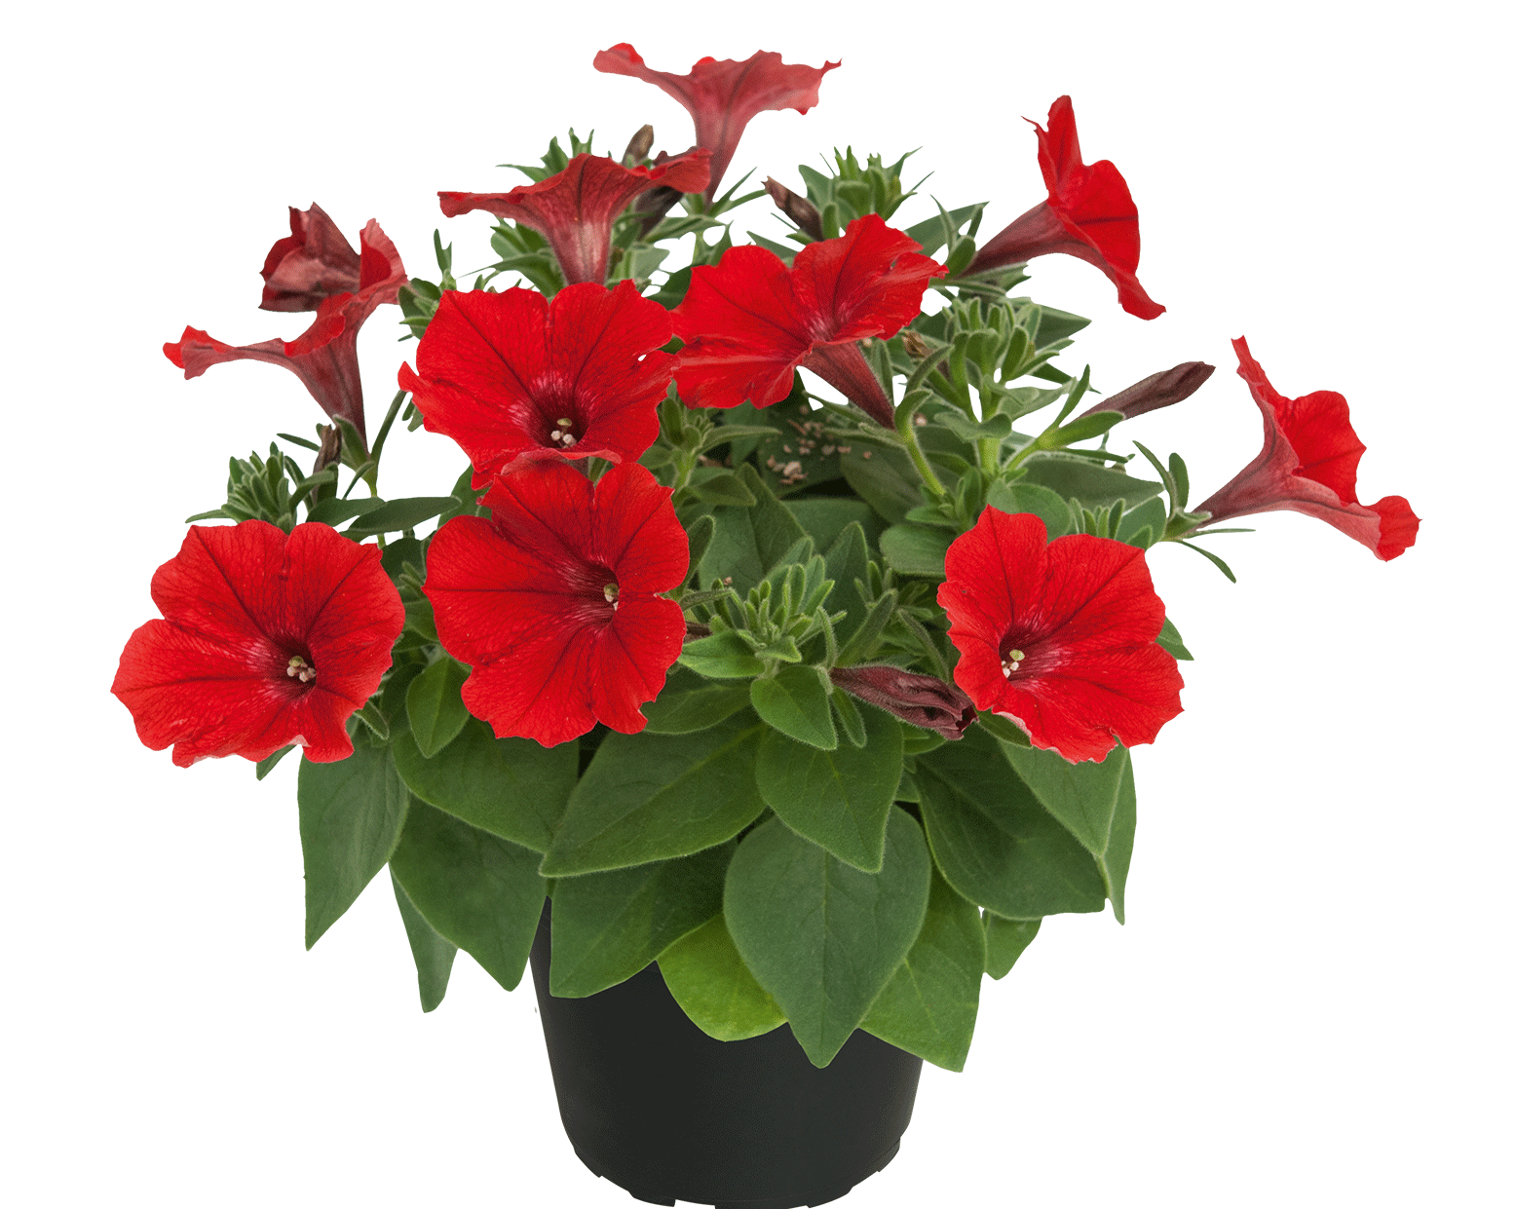
Petunia Vista Strawberry

Slide 48
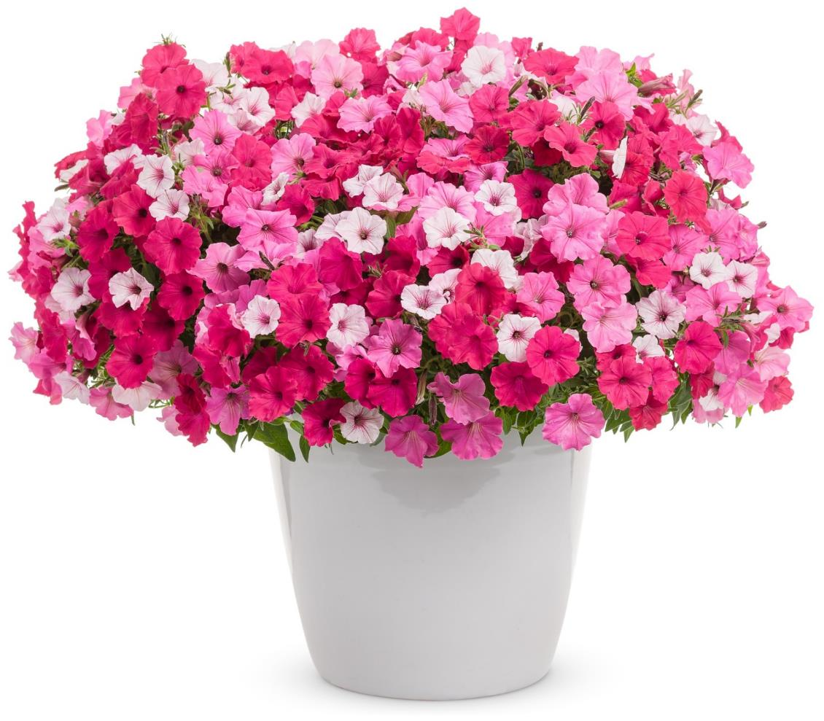
Petunia TrioMio Vista BellaVista

Slide 49
Petunia TrioMio MiniVista Harlequin

Slide 50
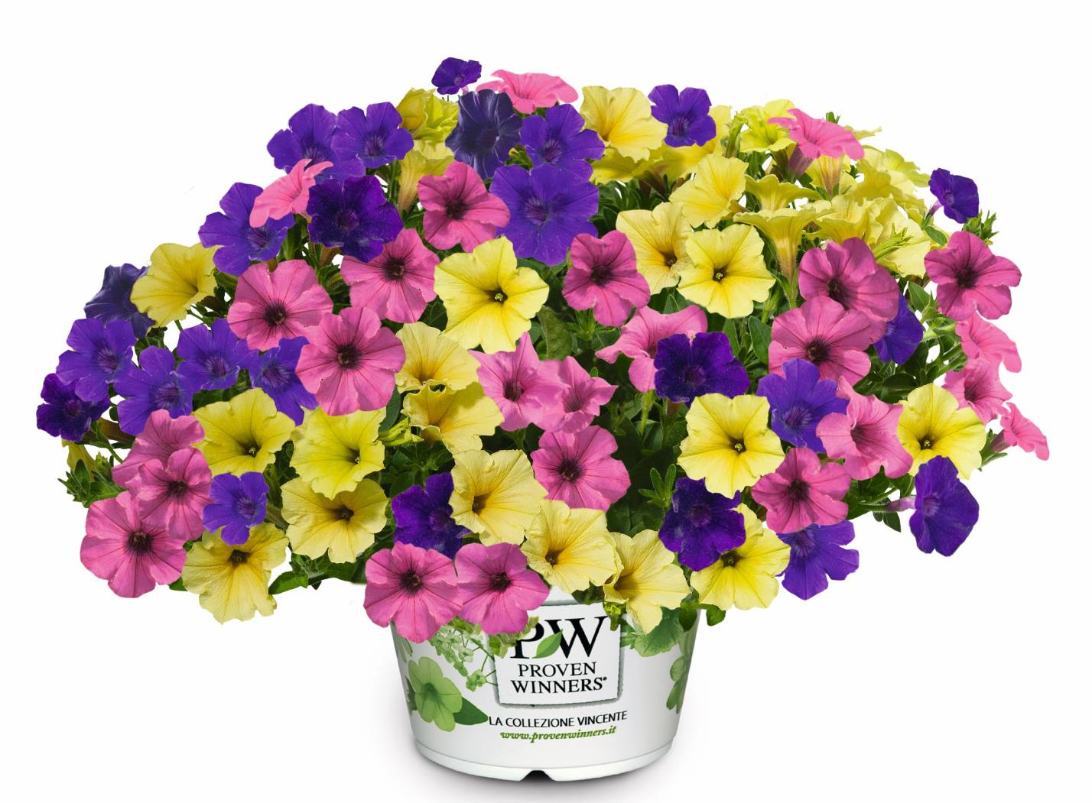
Petunia TrioMio MiniVista Joker

Slide 51
Petunia TrioMio MiniVista Majesty

Slide 52
Petunia Blueberry Twist

Slide 53
Petunia Cassis Queen 2025

Slide 54
Petunia PIZZAZZ Indigo

Slide 55
Petunia KUYAMBA White 2025

Slide 56
Petunia VERANDA Dark Blue 2025

Slide 57
Petunia Beautical Rose Star

Slide 58
Petunia Beautical Pretty Pink

Slide 59
Petunia TrioMio Beautical Pretty

Slide 60
Salvia Visional Pink

Slide 61
Scabiosa Laurie

Slide 62
Scaevola STARDIVA
NEU

Slide 63
Scaevola STARDIVA PinkStar

Slide 64
Sutera EVEREST Pink 2025

Slide 65
Torenia Vivia Amethyst

Slide 66
TrioMio™ Just White

Slide 67
Verbena Vepita Midnight

Slide 68
Verbena Vepita Red-White 2025

Slide 69
Verbena Vepita Peach 2025

